Slide 1
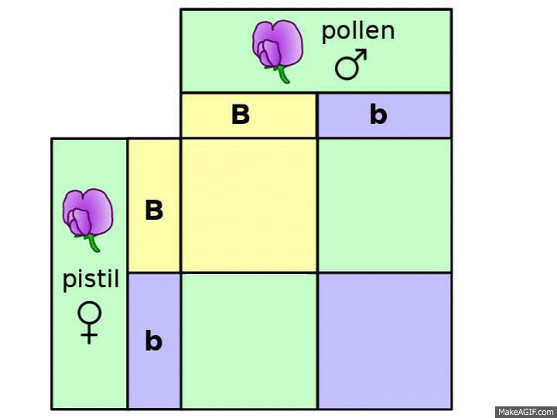
Solving Genetics Problems
Punnett Squares vs. Probability Rules

Slide 2
The Product Rule
the probability of two (or more) independent events occurring together can be calculated by multiplying the individual probabilities of the events
Example: The probability of rolling a 2 on a die is 1/6, therefore the probability of obtaining a 2 on both dice rolled at the same time is:
$\frac{1}{6}×\frac{1}{6}=\frac{1}{36}$

Slide 3
The Product Rule can be used to determine the probability of fertilization events
Problem
What is the chance of getting an offspring with a genotype of “aa” from the cross between two heterozygous parents
(Aa X Aa)?
https://www.khanacademy.org/science/biology/classical-genetics/mendelian--genetics/a/probabilities-in-genetics

Slide 4
The Sum Rule of Probability
the probability that any of several mutually exclusive events will occur is equal to the sum of the events’ individual probabilities.
Example: What are the chances of rolling either a 1 or a 6 on a die? The chances of getting either a 1 or a 6 are: (probability of getting a 1) + (probability of getting a 6)
$\frac{1}{6}+\frac{1}{6}=\frac{2}{6}=$ $\frac{1}{3}$

Slide 5
Using the Sum Rule of Probability to determine to solve genetics problems
Problem
Solution
What is the chance of an offspring showing a dominant phenotype of a cross between two parents Aa X Aa?
3 possibilities which would yield an offspring with a dominant phenotype:
Mom gives and A
Dad gives and A
Both parents give an A
https://www.khanacademy.org/science/biology/classical-genetics/mendelian--genetics/a/probabilities-in-genetics

Slide 6
Summary
Product Rule of Probability
Sum Rule of Probability
For independent events X and Y, the probability (P) of them both occurring (X and Y) is P(X)⋅P(Y)
For mutually exclusive events X and Y, the probability (P) that one will occur (X or Y) is P(X) + P(Y)
https://www.khanacademy.org/science/biology/classical-genetics/mendelian--genetics/a/probabilities-in-genetics

Slide 7
Probability Rules and Dihybrid Crosses
Problem
Using Probability Rules
Consider the cross between two dogs with the genotype BbCc, where dominant allele B specifies black coat color (b, yellow) and dominant allele C specifies straight fur ( c, curly fur). Assuming that the two genes assort independently and are not sex-linked, how can we predict the number of BbCc puppies among the offspring?
What is the probability of getting Bb?
What is the probability of getting Cc?
Which rule should we use to calculate?
Product rule b/c we have to get Bb and Cc
https://www.khanacademy.org/science/biology/classical-genetics/mendelian--genetics/a/probabilities-in-genetics

Slide 8
https://www.khanacademy.org/science/biology/classical-genetics/mendelian--genetics/a/probabilities-in-genetics

Slide 9
Multi-hybrid Crosses
Problem
Solution
Consider the cross between AaBbCCdd x AabbCcDd.
What is the chance of getting a dominant phenotype for all four traits?
Each phenotype is an independent event $∴$ you must find the probability of each individual event and multipy them together.
Aa X Aa : $P= \frac{1}{2} Aa+ \frac{1}{4}AA= \frac{3}{4}$ dominant
Bb X bb : $P= \frac{1}{2} Bb+ \frac{1}{2}bb= \frac{1}{2}$ dominant
CC X Cc : $P= \frac{1}{2} CC+ \frac{1}{2}Cc= \frac{4}{4}$ dominant
Dd X Dd : $P= \frac{1}{2} dd+ \frac{1}{2} Dd= \frac{1}{2}$ dominant
$∴\left(\frac{3}{4}\right)\left(\frac{1}{2}\right)$ $\left(\frac{4}{4}\right)\left(\frac{1}{2}\right)= \frac{12}{64}= \frac{3}{16}$ will display the dominant phenotype
You must use both the sum and product rules of probability!

Slide 10
Homework
Answer genetics questions booklet

