Slide 1
Genetics

Slide 2
What is the study of Genetics?
Science of heredity or the passing on of traits from one generation to the next
Study of genes and their transmission to new generations

Slide 3
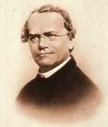
Gregor Mendel
Student in early 1800’s who studied math and science
Tended the gardens in a monastery
Worked with pea plants to
study how traits are passed
down from one generation
to the next
1

Slide 4
Why Pea Plants?
True-breeders ⇒ if self-pollinated, they give rise to identical plants/offspring (also called pure-breds)
Easy to control breeding through cross-pollination
Give many offspring so results were more statistically sound

Slide 5
Heads or Tails?
Flip a coin 20 times.
How many times landed heads? Tails?
Add up class results. How many times landed heads? Tails?
Why are the class statistics more sound than those of each individual?

Slide 6
Mendel’s Experiments
Used cross-pollination to make 7 crosses
Tested 7 genes where each gene had 2 variations each
Therefore he obtained 14 different pure-breds

Slide 7
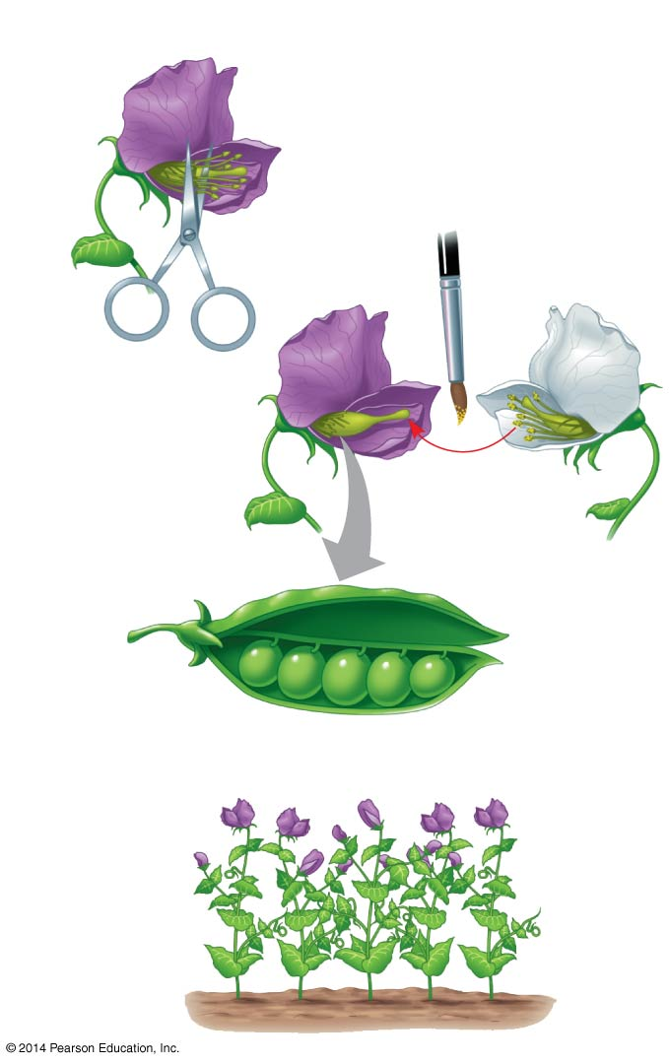
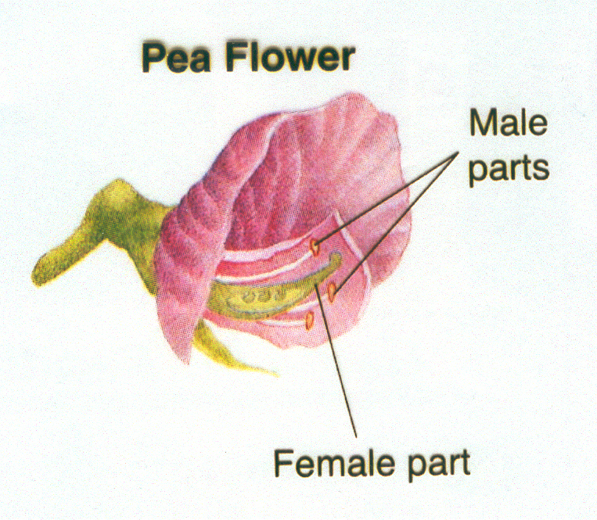
Cross-fertilization

Slide 8
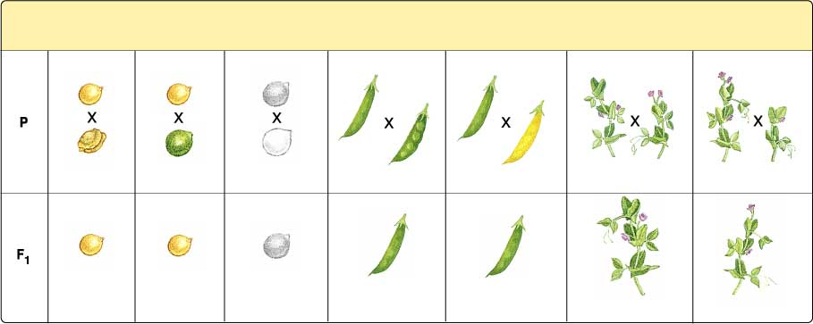
Mendel’s Crosses
Seed Shape
Seed Color
Seed Coat
Color
Pod
Shape
Pod Color
Flower Position
Plant Height
Round
Yellow
Gray
Smooth
Green
Axial
Tall
Wrinkled
Green
White
Constricted
Yellow
Terminal
Short

Slide 9
Results from Mendel’s 1st Crosses
Seed Shape
Seed Color
Seed Coat
Color
Pod
Shape
Pod Color
Flower Position
Plant Height
Round
Yellow
Gray
Smooth
Green
Axial
Tall
Wrinkled
Green
White
Constricted
Yellow
Terminal
Short
Round
Yellow
Gray
Smooth
Green
Axial
Tall

Slide 10
Menel’s Results

Slide 11
Mendelian Vocabulary
P (parental generation)
F₁ – first filial generation – the offspring resulting from a cross between the parents from the P generation
F₂ – 2nd filial generation – the offspring resulting from a cross between the F1 generation
Hybrids – the offspring of crosses between parents with different alleles/traits

Slide 12
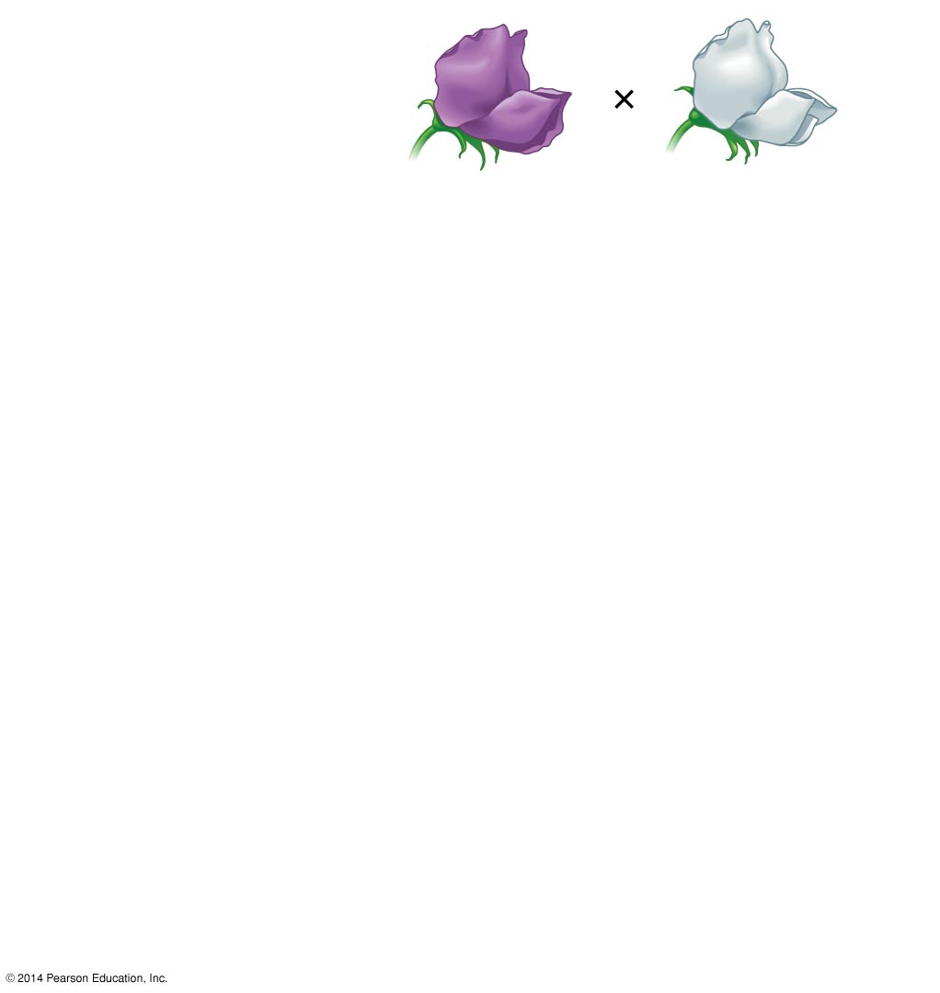
Experiment
P Generation
(true-breeding
parents)
Purple flowers
White flowers
Notes:
Figure 11.3-1 Inquiry: When F₁ hybrid pea plants self- or cross-pollinate, which traits appear in the F₂ generation? (step 1)

Slide 13
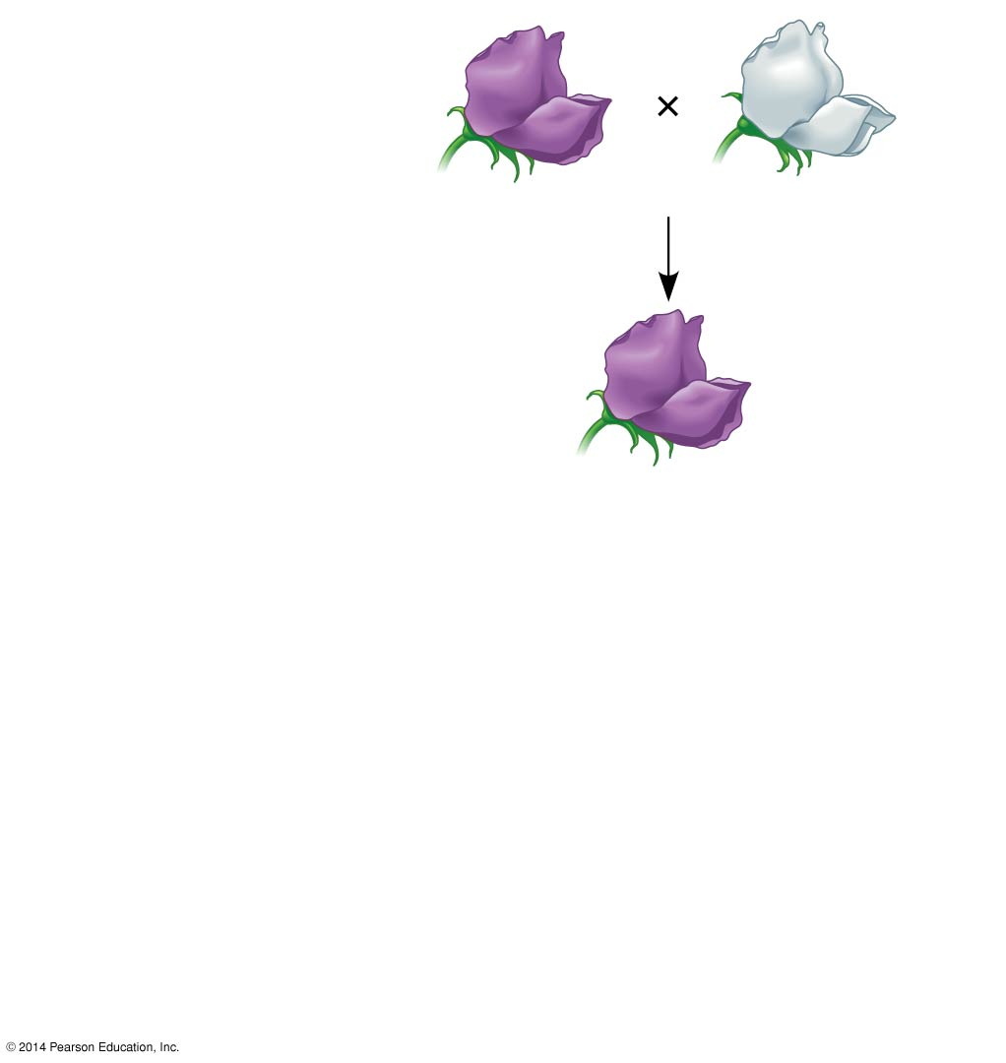
Experiment
P Generation
(true-breeding
parents)
Purple flowers
White flowers
F₁ Generation
(hybrids)
All plants had purple flowers
Self- or cross-pollination
Notes:
13
Figure 11.3-2 Inquiry: When F₁ hybrid pea plants self- or cross-pollinate, which traits appear in the F₂ generation? (step 2)

Slide 14
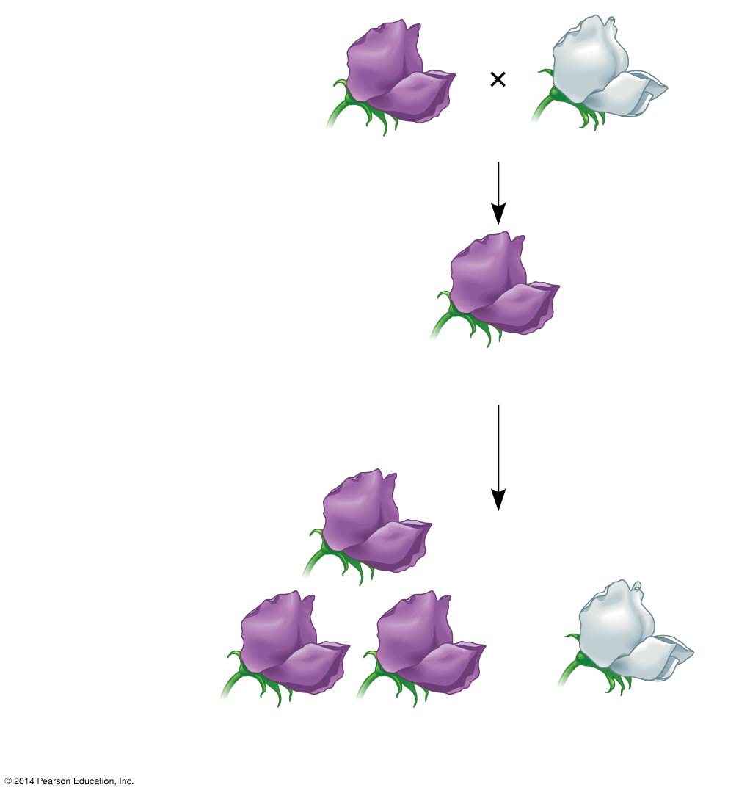
Experiment
P Generation
(true-breeding
parents)
Purple flowers
White flowers
F₁ Generation
(hybrids)
All plants had purple flowers
Self- or cross-pollination
F₂ Generation
705 purple-flowered
plants
224 white-flowered
plants
Notes:
14
Figure 11.3-3 Inquiry: When F₁ hybrid pea plants self- or cross-pollinate, which traits appear in the F₂ generation? (step 3)

Slide 15
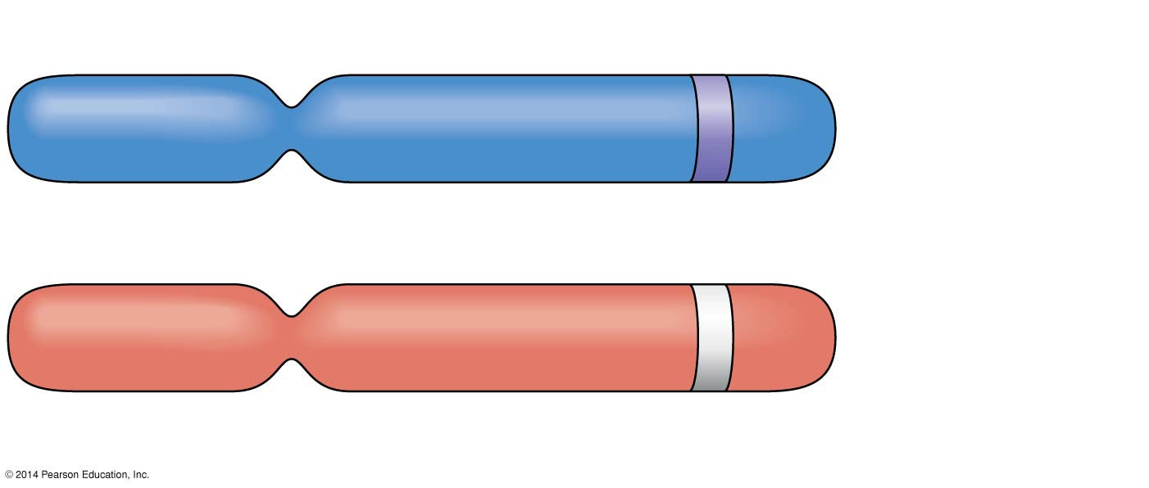
Allele for purple flowers
Pair of
homologous
chromosomes
Locus for flower-color gene
Allele for white flowers
Notes:
15
Figure 11.4 Alleles, alternative versions of a gene

Slide 16
P Generation
Appearance:
Genetic makeup:
Purple flowers
PP
White flowers
pp
Gametes:
P
p
Notes:
16
Figure 11.5-1 Mendel’s law of segregation (step 1)

Slide 17
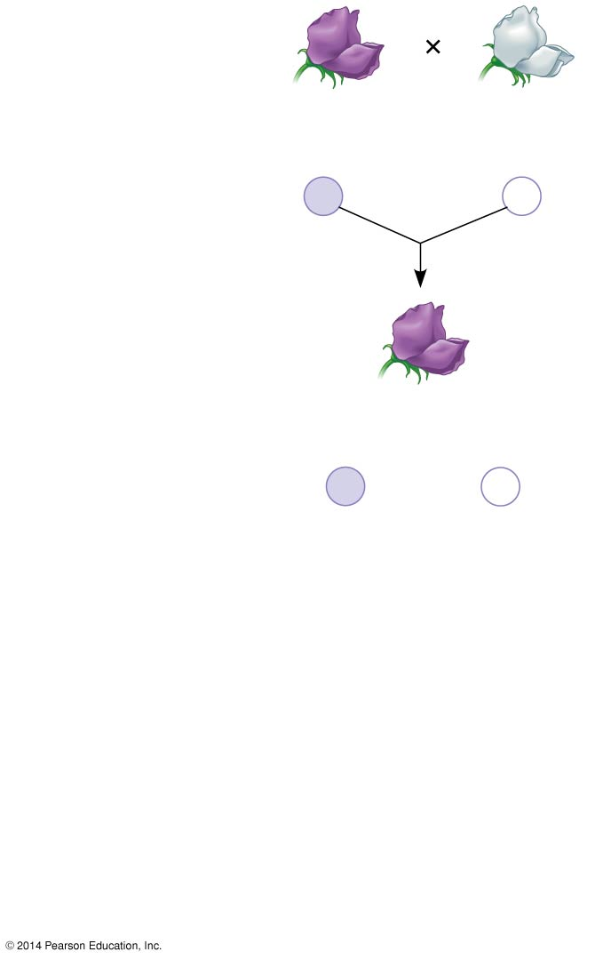
Figure 11.5-2
P Generation
Appearance:
Genetic makeup:
Purple flowers
PP
White flowers
pp
Gametes:
P
p
F₁ Generation
Appearance:
Genetic makeup:
Purple flowers
Pp
Gametes:
½
P
½
p
Notes:
17
Figure 11.5-2 Mendel’s law of segregation (step 2)

Slide 18
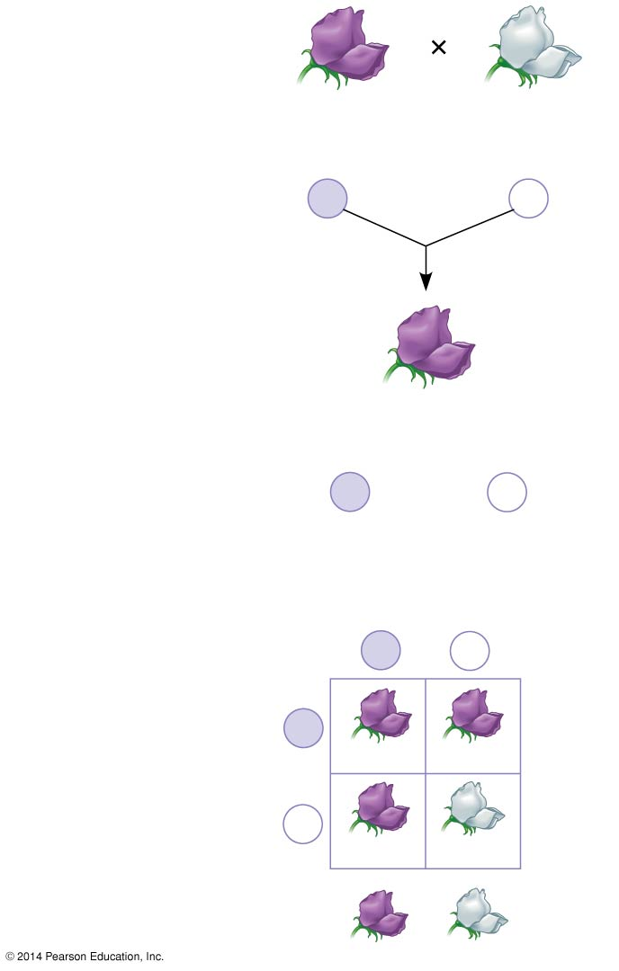
Figure 11.5-3
P Generation
Appearance:
Genetic makeup:
Purple flowers
PP
White flowers
pp
Gametes:
P
p
F₁ Generation
Appearance:
Genetic makeup:
Purple flowers
Pp
Gametes:
½
P
½
p
Sperm from
F₁ (Pp) plant
F₂ Generation
P
p
P
Eggs from
F₁ (Pp) plant
PP
Pp
p
Pp
pp
3
: 1
Notes:
18
Figure 11.5-3 Mendel’s law of segregation (step 3)

Slide 19
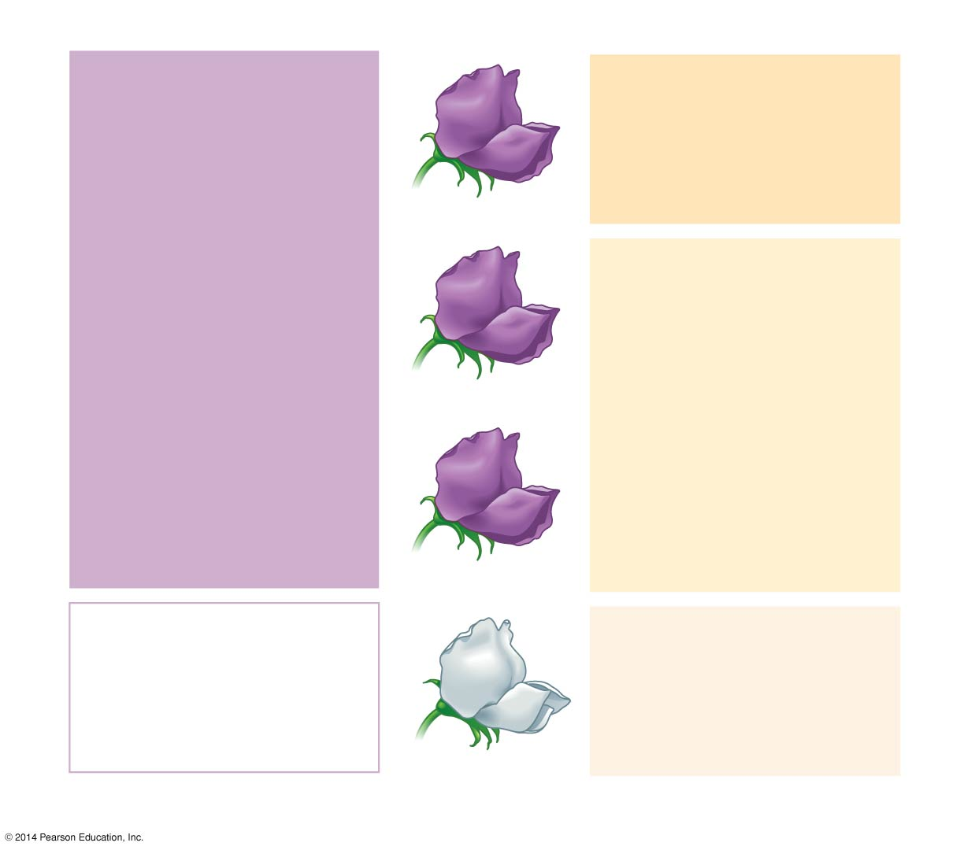
Phenotype
Genotype
Purple
PP
(homozygous)
1
3
Purple
Pp
(heterozygous)
2
Purple
Pp
(heterozygous)
1
White
pp
(homozygous)
1
Ratio 3:1
Ratio 1:2:1
Notes:
19
Figure 11.6 Phenotype versus genotype

Slide 20
How can you tell whether something displaying a dominant phenotype is homozygous or heterozygous?

Slide 21
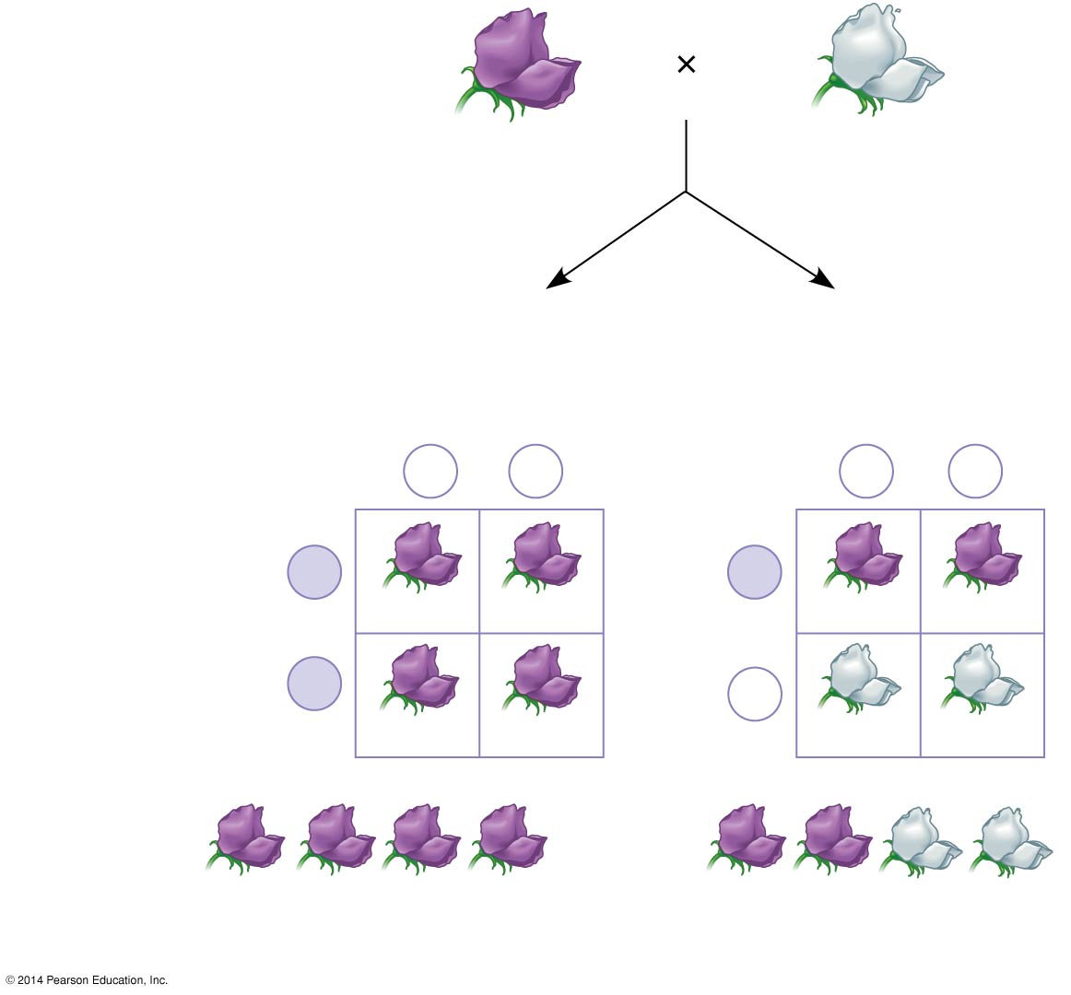
Technique
Test Cross/Back Cross
Dominant phenotype,
unknown genotype:
PP or Pp?
Recessive phenotype,
known genotype:
pp
Predictions
If purple-flowered
parent is PP
or
If purple-flowered
parent is Pp
Sperm
Sperm
p
p
p
p
P
P
Eggs
Pp
Pp
Eggs
Pp
Pp
P
p
Pp
Pp
pp
pp
Results
or
All offspring purple
½ offspring purple and
½ offspring white
Notes:
21
Figure 11.7 Research method: the testcross

Slide 22
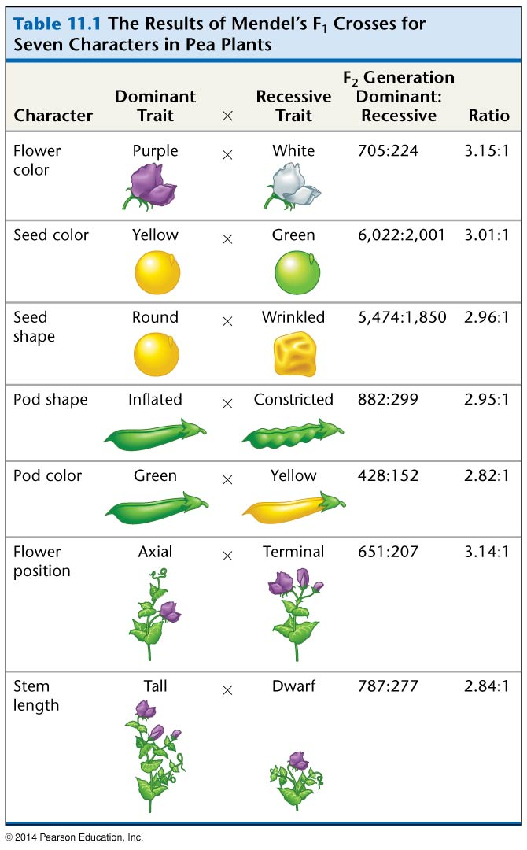
Table 11.1
Notes:
22
Table 11.1 The results of Mendel’s F₁ crosses for seven characters in pea plants

Slide 23
First Conclusions
Biological inheritance is determined by « factors » that are passed from one generation to the next. Today we call these factors « Genes »
Each of the 7 traits Mendel studied were governed by only one gene and each gene had 2 possible variations. The different variations for each gene are called « alleles »
Example: The height gene for pea plants has two variants
Tall and Dwarf alleles

Slide 24
First Conclusions
Mendel came up with 3 basic principles/laws based on his results:
The Principle of DOMINANCE
The Law of SEGREGATION
The Principle of INDEPENDENT ASSORTMENT

Slide 25
Principle of Dominance
Principle of Dominance – states that some alleles are dominant and others are recessive.
Tall allele – dominant
Dwarf allele - recessive

Slide 26
Principle of Dominance
Dominant Alleles – if the offspring receives a dominant allele they will express the dominant trait even if it receives one dominant allele and one recessive
Recessive Alleles – an offspring can only express the recessive trait in the absence of a dominant allele. That is it must receive a recessive allele fromboth its parents.

Slide 27
The Law of Segregation
An individual contains factors (genes) in pairs. These paired factors (alleles) segregate from one another and are distributed into different sex cells. Each parent can only contribute one member of a pair of factors (alleles) to their offspring (sex cells/gametes/germ cell).

Slide 28
Applying the Law of Segregation
Monohybrid Cross
Mono – one trait
Hybrid – not pure (offspring of parents differing in one trait)
Problem : A plant grown from heterozygous round seeds is crossed with a plant grown from wrinkled seeds.

Slide 29
P (parents) have the Phenotypes
round seed X wrinkled seeds
The trait for round seeds is dominant over the trait for wrinkled seeds.
Let R = trait for round seeds
Let r = trait for wrinkled seeds
Genotypes of P are Rr x rr Why?

Slide 30
The gametes (pollen or eggs) produced by the P plants are:
Rr rr
R or r r or r

Slide 31
Punnnett Square
We use a punnett square to determine the possible genotypes of the F₁ generation
Rr♁
♂ rr
R
r
r
Rr
rr
r
Rr
rr

Slide 32
What are the possible genotypes in the F₁ generation?
What are the possible phenotypes in the F₁ generation?

Slide 33
The Principle of Independent Assortment
States that the inheritance of alleles for one trait does not affect the inheritance of alleles for another trait UNLESS both genes are located close together on the same chromosome

Slide 34
This principle means that during meiosis, when sex cells are being formed, the alleles that the parent has for a partiular trait are distributed to the gametes at RANDOM. It does not depend on which other alleles the gamete will receive.

Slide 35
During meiosis there are only 4 types of gametes that can form when considering 2 traits
R= round seed
r = wrinkled seed
Y = yellow seed
y = green seed
RrYy
RY
Ry
rY
ry

Slide 36
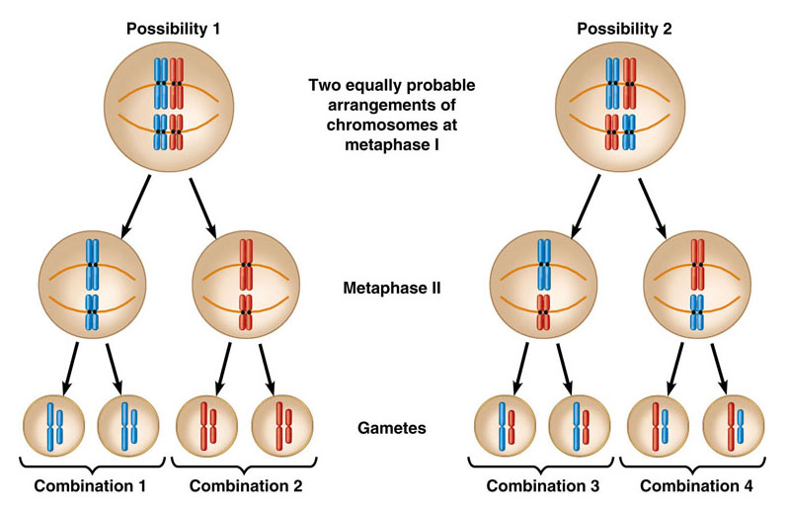

Slide 37
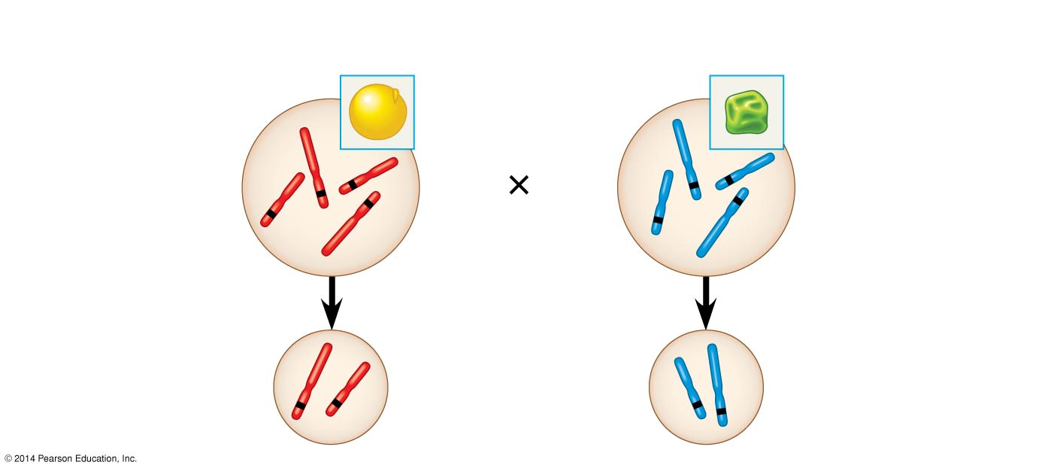
P Generation
Yellow-round
seeds (YYRR)
Green-wrinkled
seeds (yyrr)
Y
y
r
R
R
r
Y
y
Meiosis
Fertilization
R
Y
y
r
Gametes
Notes:
37
Figure 12.2a The chromosomal basis of Mendel’s laws (part 1)

Slide 38
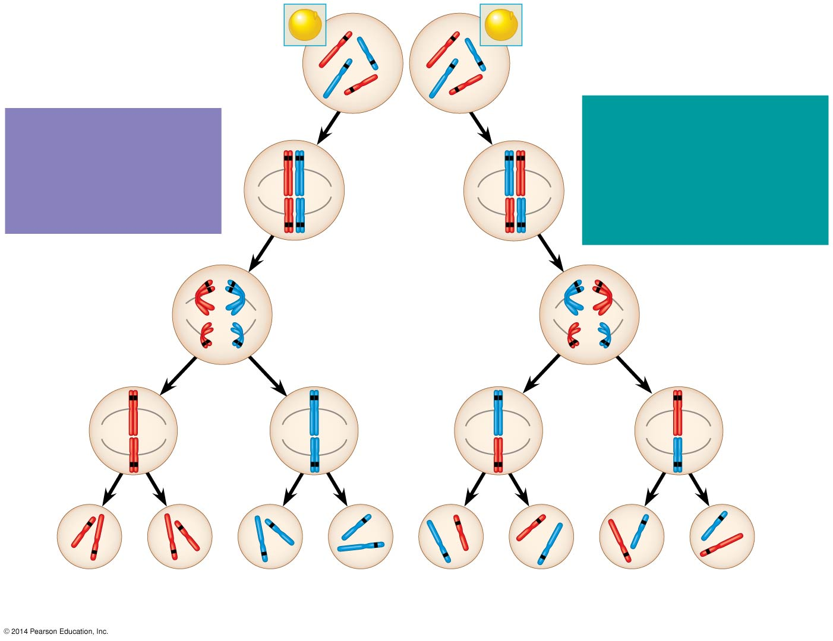
F₁ Generation
All F₁ plants produce
yellow-round seeds (YyRr).
R
R
r
y
r
y
Y
Y
LAW OF
SEGREGATION
The two alleles for
each gene separate.
Meiosis
LAW OF INDEPENDENT
ASSORTMENT
Alleles of genes on
nonhomologous
chromosomes assort
independently.
R
r
Metaphase
I
r
R
Y
y
Y
y
1
1
R
r
r
R
Anaphase I
Y
y
Y
y
R
r
Metaphase
II
r
R
2
2
Y
y
Y
y
Y
Y
y
y
Y
Y
y
y
R
R
r
r
r
r
R
R
1
/
YR
1
/
yr
1
/
Yr
1
/
yR
4
4
4
4
Notes:
38
Figure 12.2b The chromosomal basis of Mendel’s laws (part 2)

Slide 39
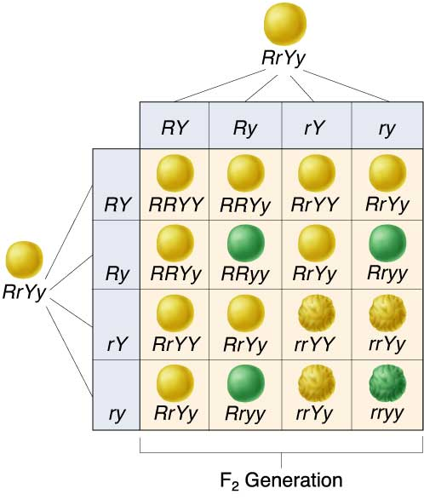
Mendel’s F₂ Generation
An F₁ × F₁ cross-fertilization
9
: 3
: 3
: 1

Slide 40
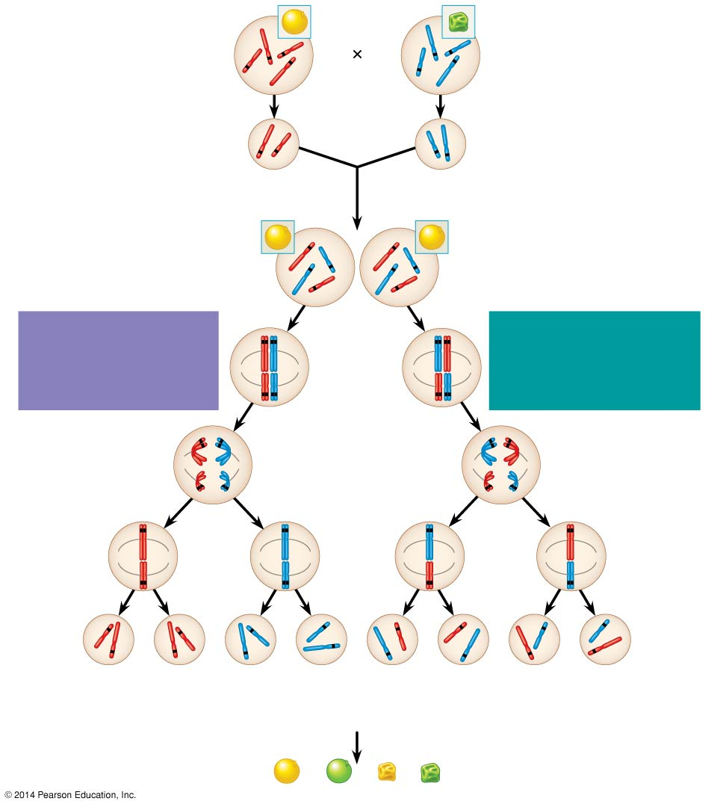
P Generation
Yellow-round
seeds (YYRR)
Green-wrinkled
seeds (yyrr)
Y
r
y
Y
R
R
y
r
Meiosis
Fertilization
y
r
Gametes
R
Y
All F₁ plants produce
yellow-round seeds (YyRr).
F₁ Generation
R
R
r
y
r
y
Y
Y
LAW OF SEGREGATION
The two alleles for each
gene separate.
Meiosis
LAW OF INDEPENDENT
ASSORTMENT Alleles of
genes on nonhomologous
chromosomes assort
independently.
R
r
Metaphase
I
r
R
Y
y
Y
y
1
1
R
r
r
R
Anaphase I
Y
y
Y
y
R
r
Metaphase
II
r
R
2
2
Y
y
Y
y
Y
Y
y
y
Y
Y
y
y
R
R
r
r
r
r
R
R
1
/
YR
1
/
yr
YR
1
/
Yr
1
/
yR
F₂ Generation
4
4
4
4
3
An F₁ × F₁ cross-fertilization
3
Fertilization
recombines the R and
r alleles at random.
Fertilization results in the
9:3:3:1 phenotypic ratio
in the F₂ generation.
9
: 3
: 3
: 1
Notes:
40
Figure 12.2 The chromosomal basis of Mendel’s laws

Slide 41
Variations on Mendel’s Laws

Slide 42
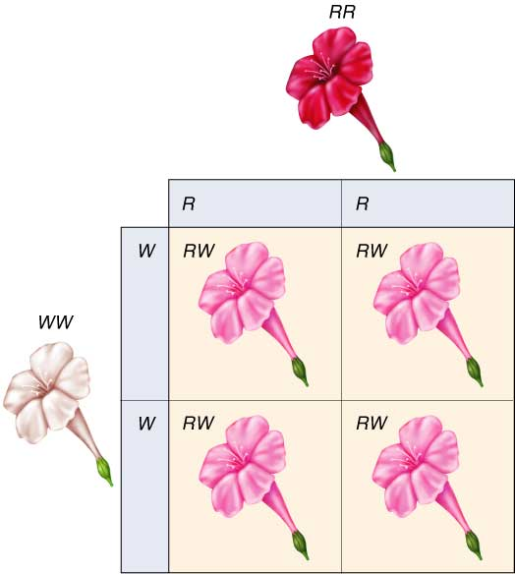
Incomplete Dominance
Neither allele is dominant over the other and you therefore get an intermediate phenotype expressing a little bit of both traits.

Slide 43
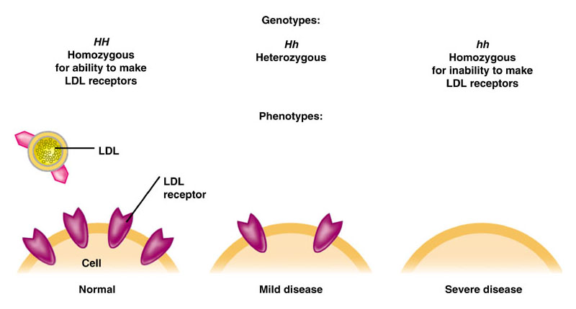
Incomplete Dominance in Hypercholesterolemia

Slide 44
Codominance
Some alleles are not totally dominant over another allele
In the case of codominance, both of the traits show up
Otherwise put, two or more alleles may influence the phenotype
Example, in Roan cows when a white cow is crossed with a red bull, you get a roan calf which is spotted red and white.

Slide 45
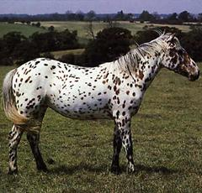
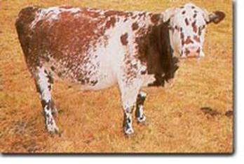
Codominance
Appaloosa
Roan

Slide 46
Multiple Alleles
Blood type is due to three alleles unlike many traits that are only due to two alleles.
The three possible alleles are
I^{A}, I^{B}, I^{O}
There are four possible phenotypes
Type AB – I^{A} & I^{B}
Type A – I^{A} & I^{A} OR I^{A} & I^{O}
Type B – I^{B} & I^{B} OR I^{B} & I^{O}
Type O – I^{O} & I^{O}

Slide 47
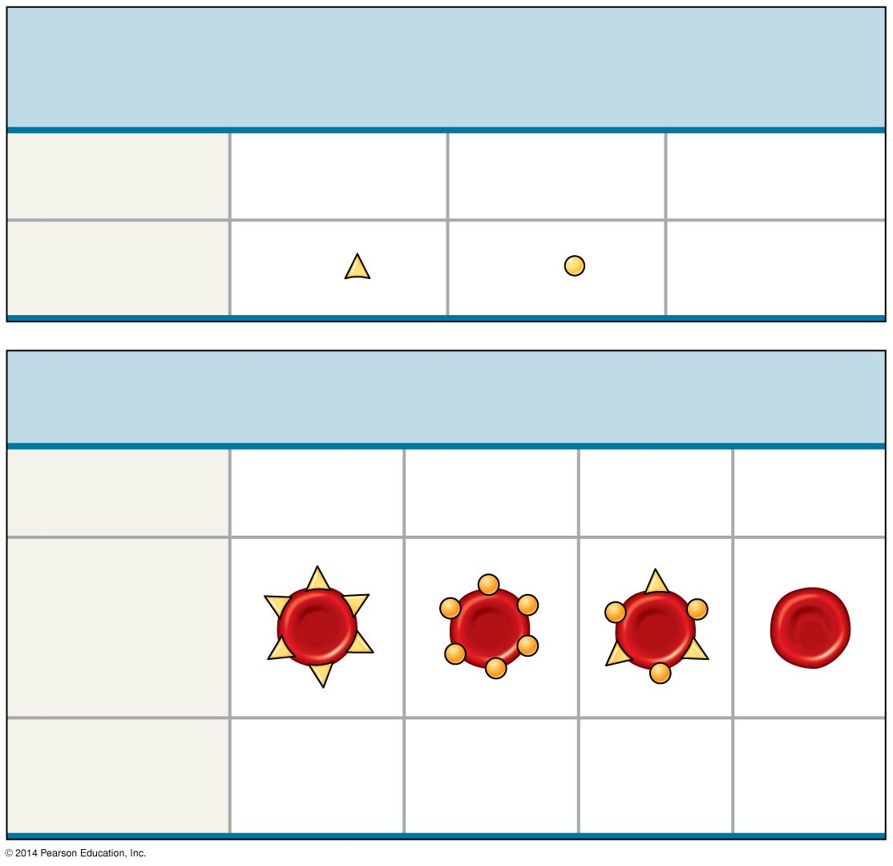
(a) The three alleles for the ABO blood groups and their
carbohydrates
Allele
I^{A}
I^{B}
i
Surface
Carbohydrate
A
B
none
(b) Blood group genotypes and phenotypes
Genotype
I^{A}I^{A} or I^{A}i
I^{B}I^{B} or I^{B}i
I^{A}I^{B}
ii
Red blood cell
appearance
Phenotype
(blood group)
A
B
AB
O
Notes:
47
Figure 11.11 Multiple alleles for the ABO blood groups

Slide 48
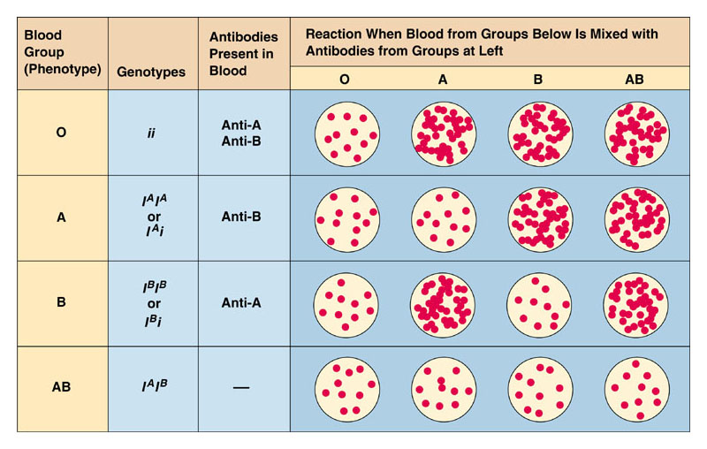
Blood Type – Multiple Alleles

Slide 49
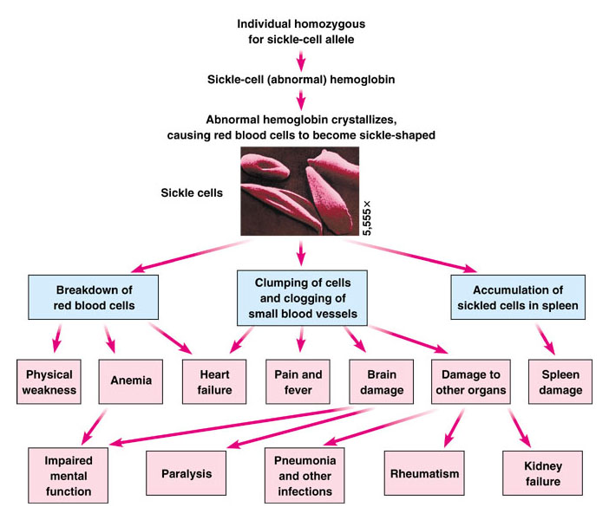
Pleiotropy

Slide 50
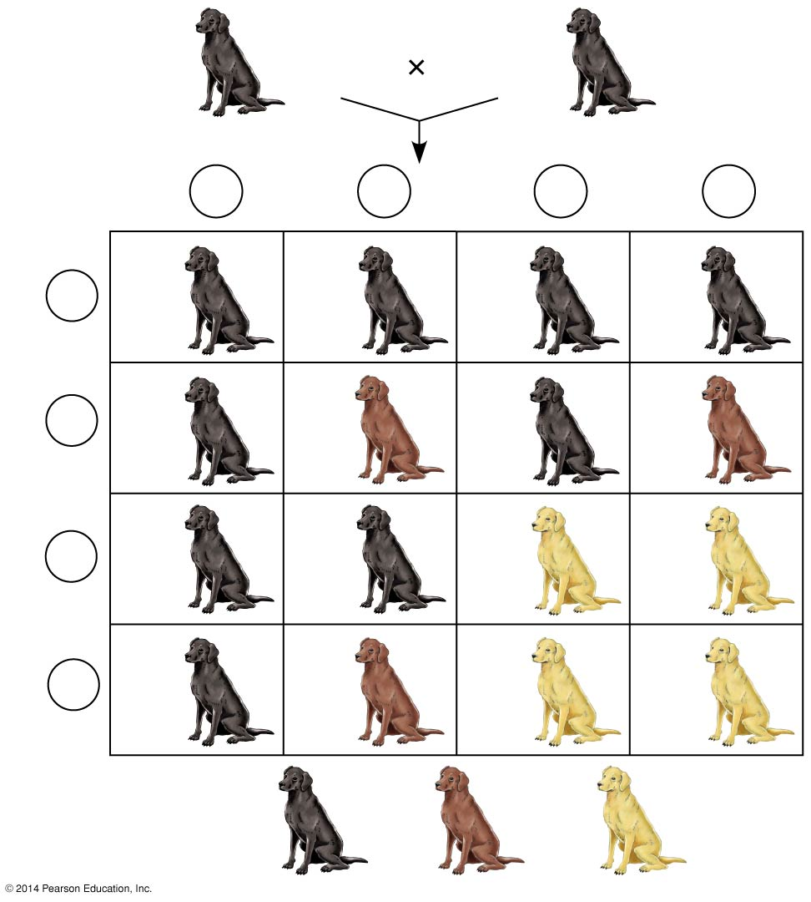
BbEe
BbEe
Epistasis
Sperm
¼
BE
¼
bE
¼
Be
¼
be
Eggs
¼
BE
BBEE
BbEE
BBEe
BbEe
¼
bE
BbEE
bbEE
BbEe
bbEe
¼
Be
BBEe
BbEe
BBee
Bbee
¼
be
BbEe
bbEe
Bbee
bbee
9
: 3
: 4
Notes:
50
Figure 11.12 An example of epistasis

Slide 51
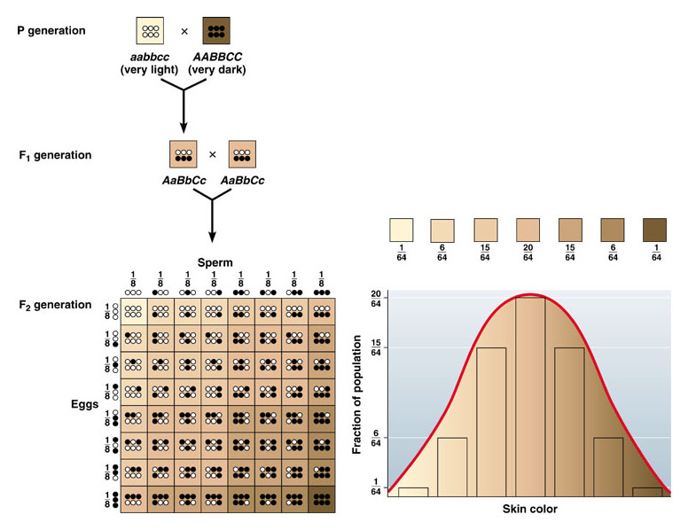
Polygenic Traits

Slide 52
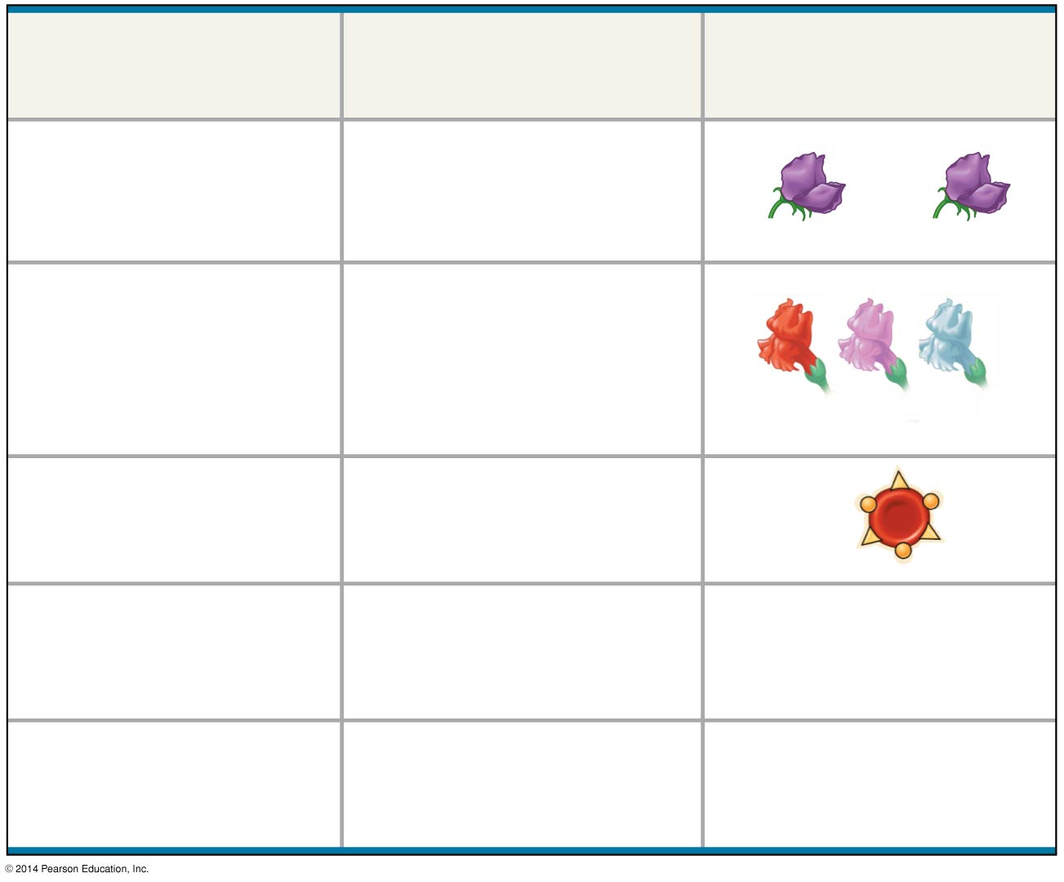
Relationship among
alleles of a single gene
Description
Example
Complete dominance
of one allele
Heterozygous phenotype
same as that of homo-
zygous dominant
PP
Pp
Incomplete dominance
of either allele
Heterozygous phenotype
intermediate between
the two homozygous
phenotypes
C^{R}C^{R}
C^{R}C^{W}
C^{W}C^{W}
Codominance
Both phenotypes
expressed in
heterozygotes
I^{A}I^{B}
Multiple alleles
In the whole population,
some genes have more
than two alleles
ABO blood group alleles
I^{A}, I^{B}, i
Pleiotropy
One gene is able to affect
multiple phenotypic
characters
Sickle-cell disease
Notes:
52
Figure 11.UN05 Summary of key concepts: single-gene Mendelian extensions

Slide 53
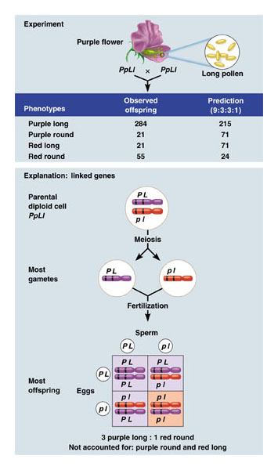
Linked Genes

Slide 54
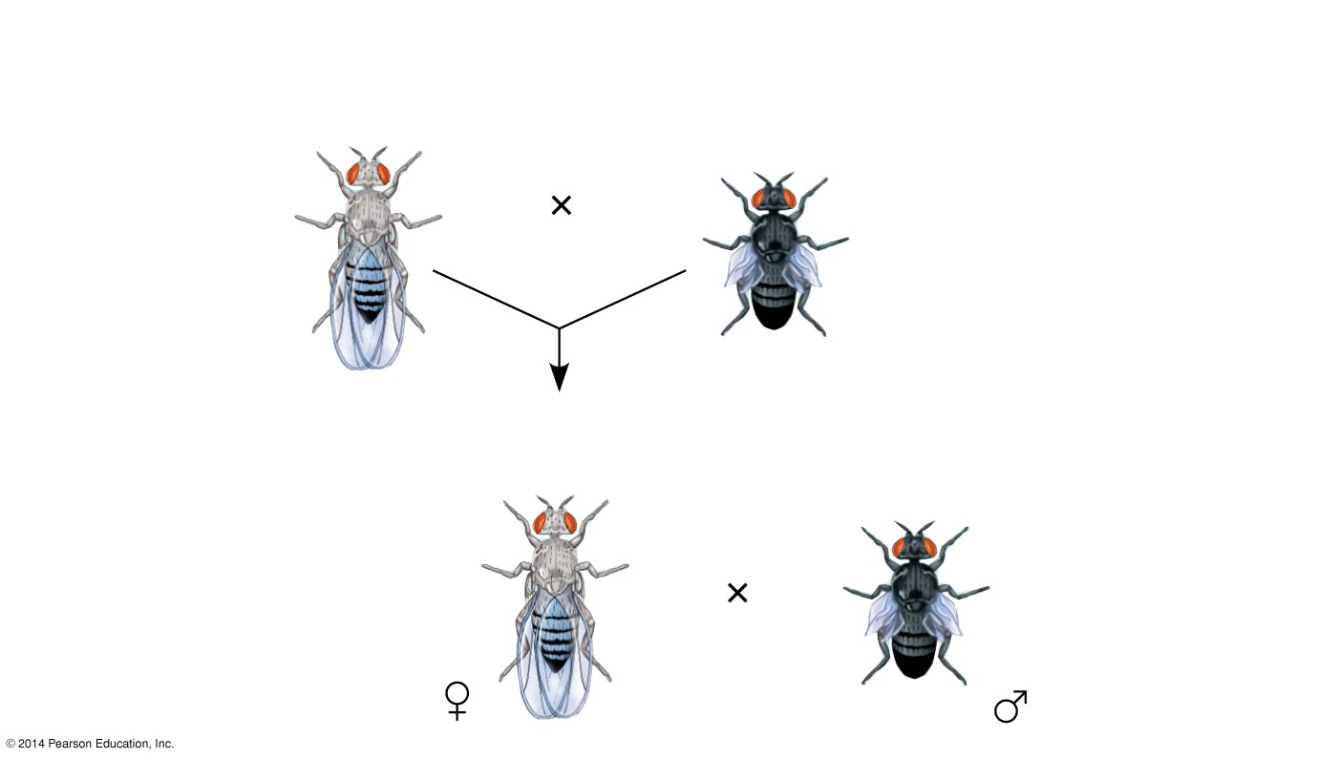
Linked Genes in Drosophila
Experiment
P Generation
(homozygous)
Wild type
(gray body,
normal wings)
Double mutant
(black body,
vestigial wings)
b⁺ b⁺ vg⁺ vg⁺
b b vg vg
F₁ dihybrid testcross
Wild-type F₁ dihybrid
(gray body, normal wings)
Homozygous
recessive (black
body, vestigial
wings)
b⁺ b vg⁺ vg
b b vg vg
Notes:
54
Figure 12.9a Inquiry: How does linkage between two genes affect inheritance of characters? (part 1: experiment)

Slide 55
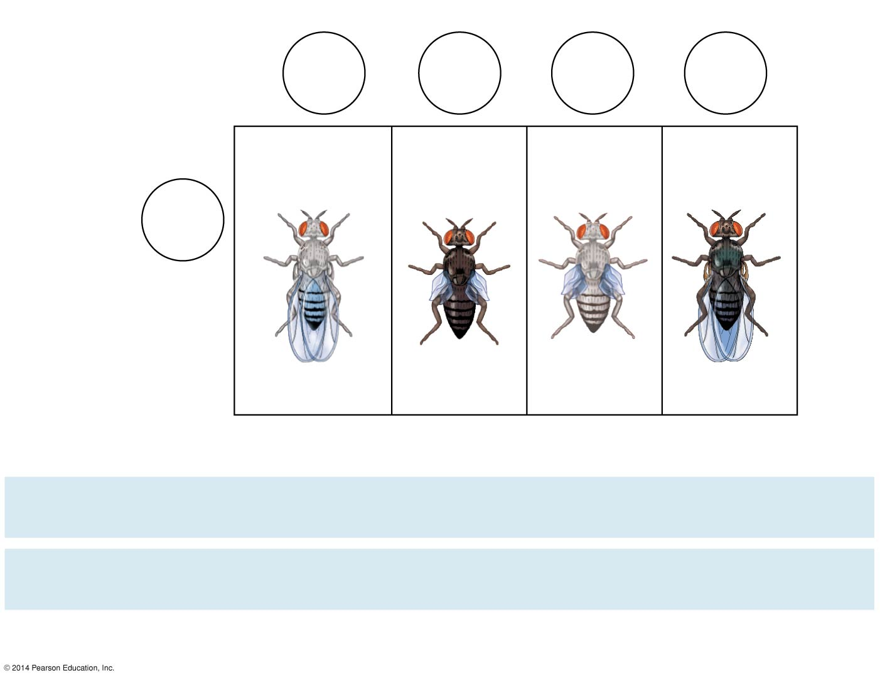
Experiment
Testcross
offspring
Eggs
b⁺ vg⁺
b vg
b⁺ vg
b vg⁺
Wild-type
(gray-normal)
Black-
vestigial
Gray-
vestigial
Black-
normal
b vg
Sperm
b⁺ b vg⁺ vg
b b vg vg
b⁺ b vg vg
b b vg⁺ vg
PREDICTED RATIOS
Genes on different
chromosomes:
1
:
1
:
1
:
1
Genes on same
chromosome:
1
:
1
:
0
:
0
Results
965
:
944
:
206
:
185
Notes:
55
Figure 12.9b Inquiry: How does linkage between two genes affect inheritance of characters? (part 2: results)

Slide 56
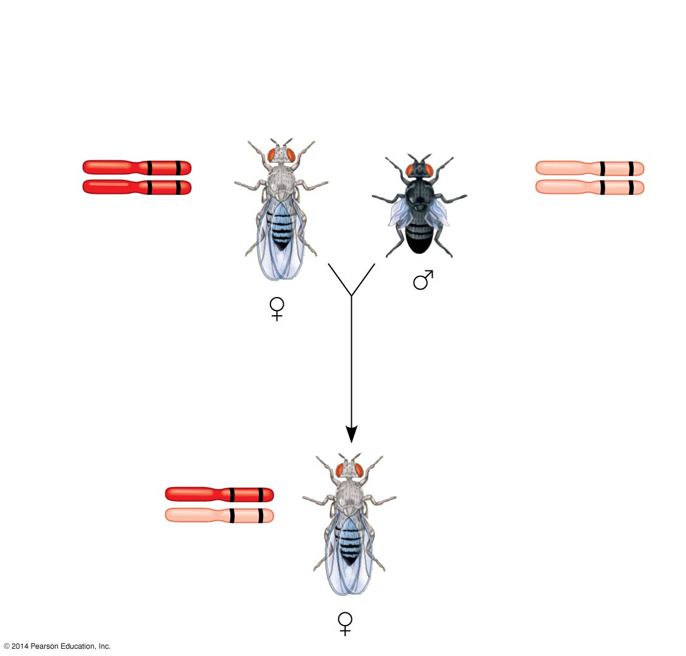
P generation (homozygous)
Wild type
(gray body,
normal wings)
Double mutant
(black body,
vestigial wings)
b⁺ vg⁺
b vg
b⁺ vg⁺
b vg
Wild-type F₁ dihybrid
(gray body,
normal wings)
b⁺ vg⁺
b vg
Notes:
56
Figure 12.10a Chromosomal basis for recombination of linked genes (part 1: F₁ dihybrid)

Slide 57
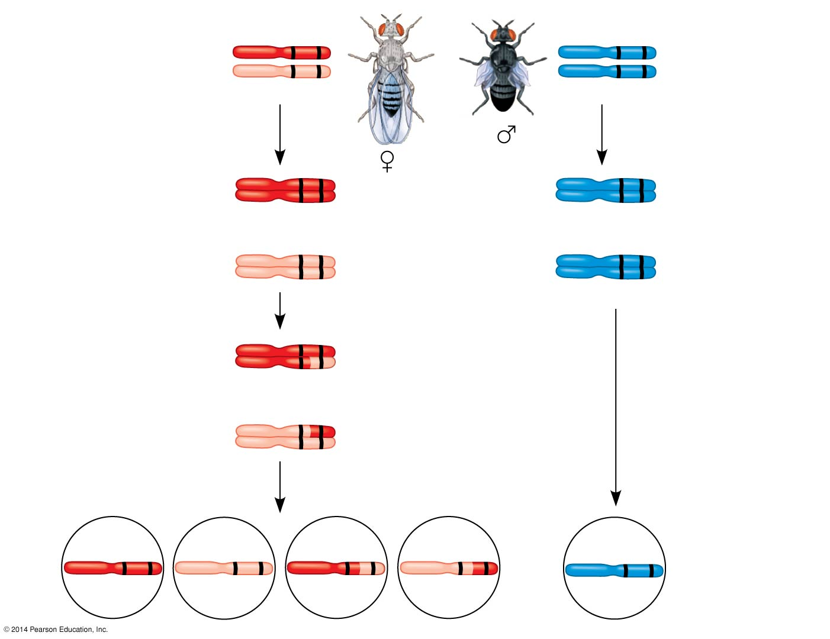
F₁ dihybrid testcross
b⁺ vg⁺
b vg
Wild-type F₁
dihybrid
(gray body,
normal wings)
Homozygous
recessive
(black body,
vestigial wings)
b vg
b vg
b⁺ vg⁺
b vg
b⁺ vg⁺
b vg
b vg
b vg
Meiosis I
b vg
b vg
b⁺ vg⁺
Meiosis I and II
b⁺ vg
b vg⁺
b vg
Recombinant
chromosomes
Meiosis II
b⁺ vg⁺
b vg
b⁺ vg
b vg⁺
b vg
Eggs
Sperm
Notes:
57
Figure 12.10b Chromosomal basis for recombination of linked genes (part 2: testcross)

Slide 58
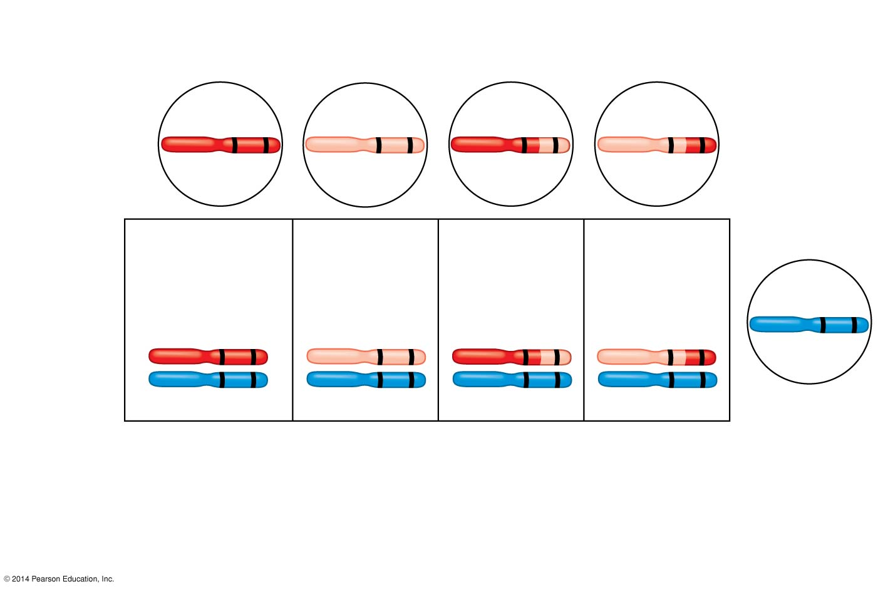
Recombinant
chromosomes
b⁺ vg⁺
b vg
b⁺ vg
b vg⁺
Eggs
Testcross
offspring
965
Wild type
(gray-normal)
944
Black-
vestigial
206
Gray-
vestigial
185
Black-
normal
b vg
b⁺ vg⁺
b vg
b⁺ vg
b vg⁺
b vg
b vg
b vg
b vg
Sperm
Parental-type offspring
Recombinant offspring
Recombination
frequency
391 recombinants
× 100 = 17%
=
2,300 total offspring
Notes:
58
Figure 12.10c Chromosomal basis for recombination of linked genes (part 3: testcross offspring)

Slide 59
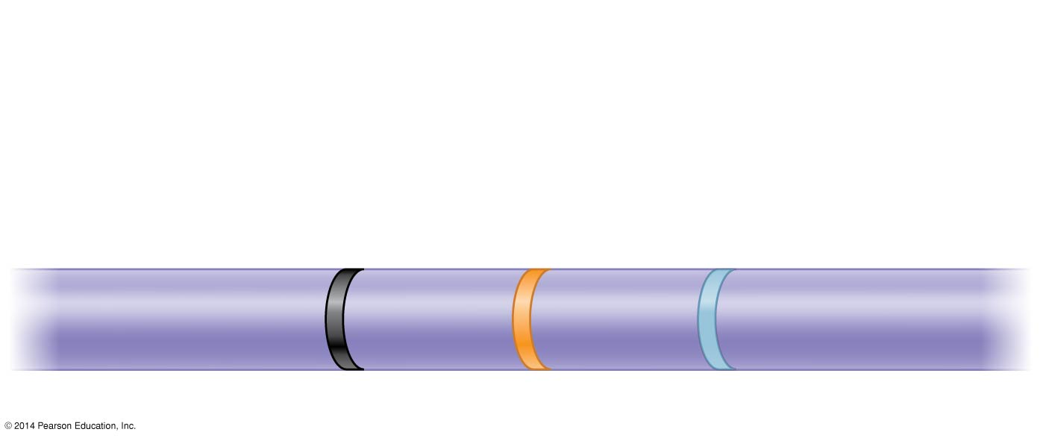
Results
Recombination
frequencies
9%
9.5%
Chromosome
17%
b
cn
vg
Notes:
59
Figure 12.11 Research method: constructing a linkage map

Slide 60
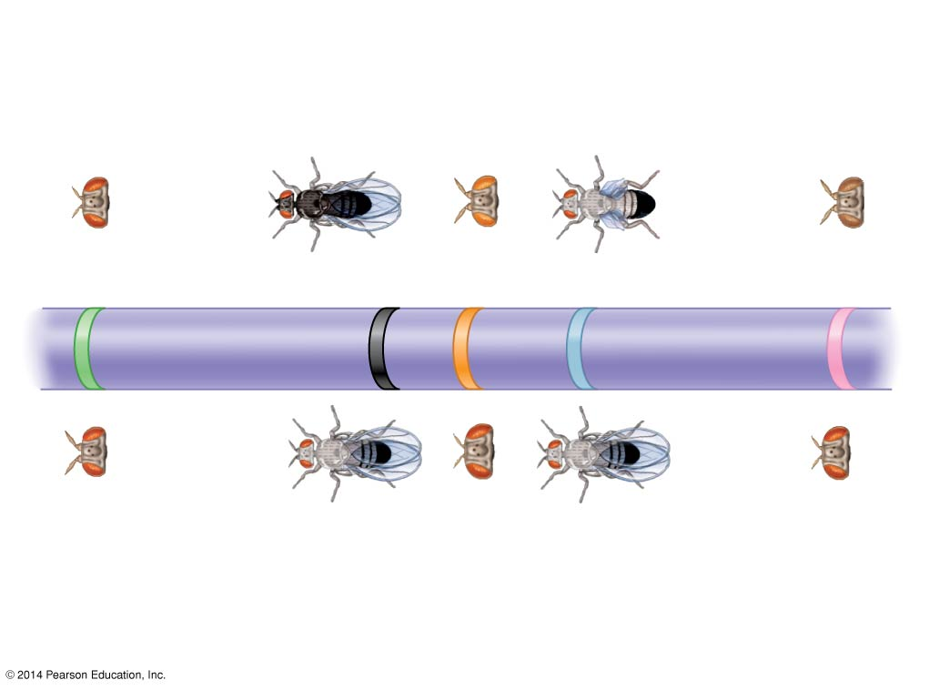
Mutant phenotypes
Short
aristae
Black
body
Cinnabar
eyes
Vestigial
wings
Brown
eyes
0
48.5
57.5
67.0
104.5
Long aristae
(appendages
on head)
Gray
body
Red
eyes
Normal
wings
Red
eyes
Wild-type phenotypes
Notes:
60
Figure 12.12 A partial genetic (linkage) map of a Drosophila chromosome

Slide 61
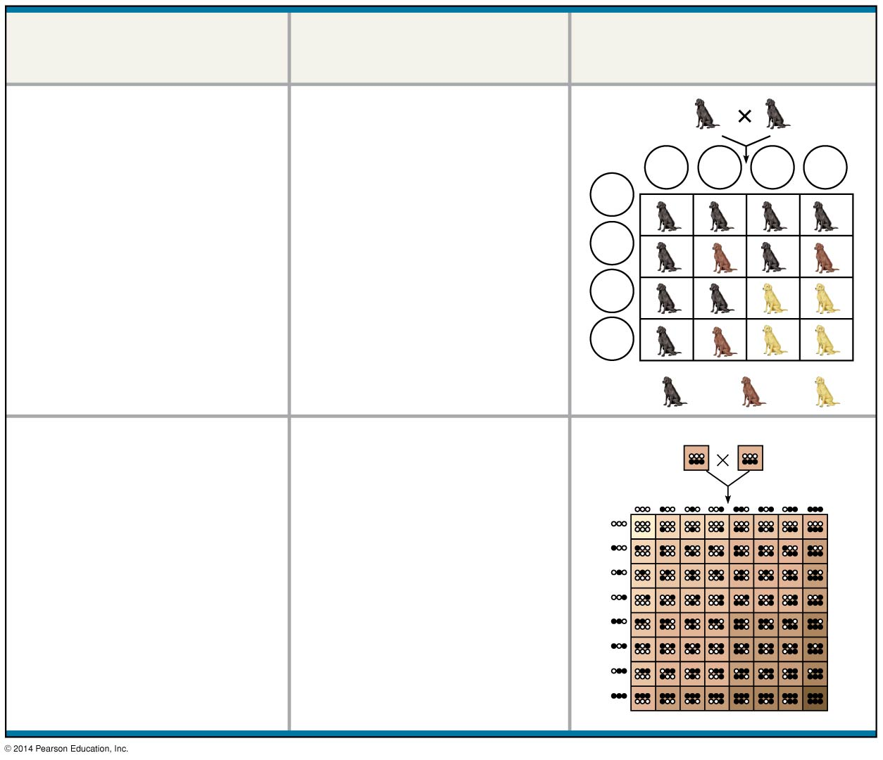
Relationship among
two or more genes
Description
Example
Epistasis
The phenotypic
expression of one gene
affects the expression
of another gene
BbEe
BbEe
BE
bE
Be
be
BE
bE
Be
be
9
: 3
: 4
Polygenic inheritance
A single phenotypic
character is affected by
two or more genes
AaBbCc
AaBbCc
Notes:
61
Figure 11.UN06 Summary of key concepts: multi-gene Mendelian extensions

Slide 62
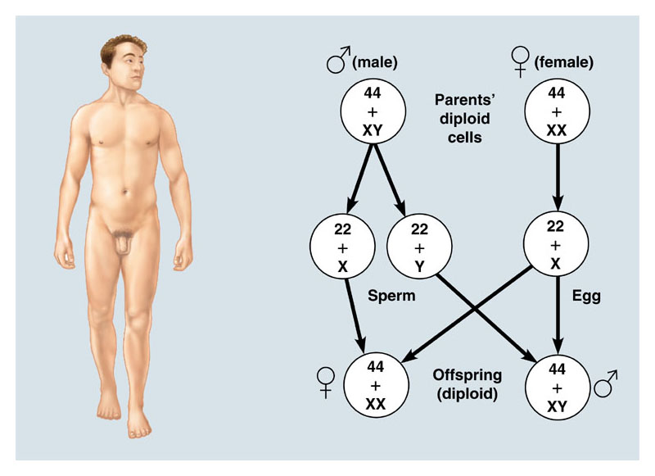
Sex Determination

Slide 63
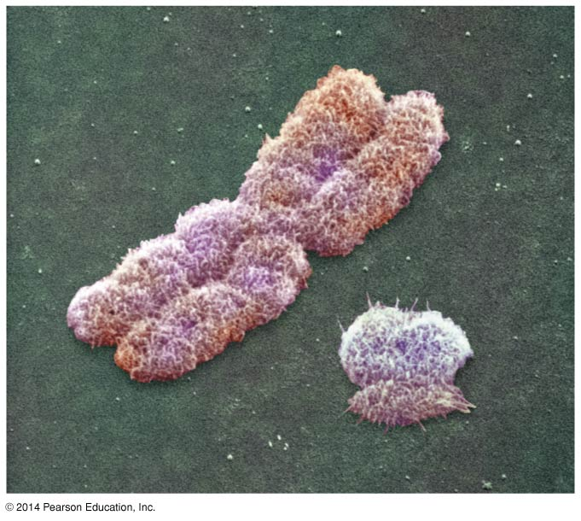
Sex-Linked Traits
Those traits carried by genes found on the X chromosome, and not on the Y.
X
Y

Slide 64
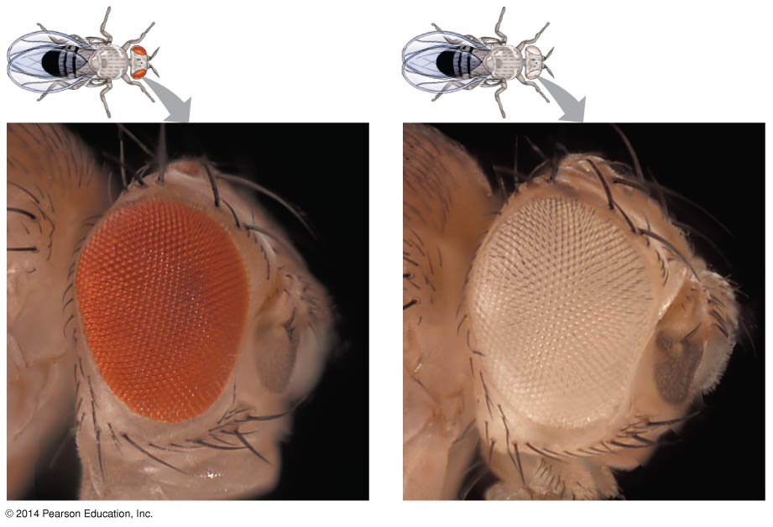
Notes:
64
Figure 12.3 Morgan’s first mutant

Slide 65
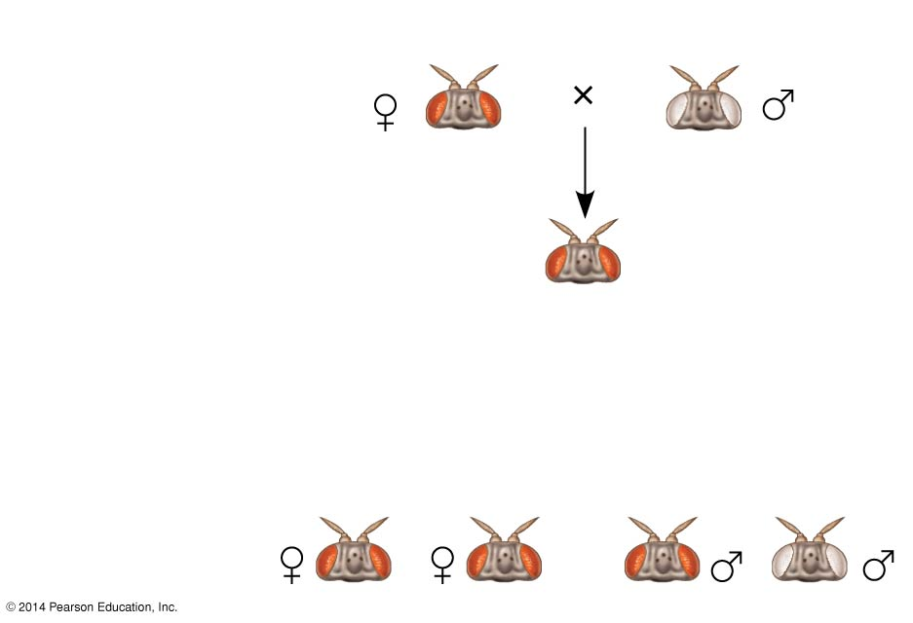
Experiment
P
Generation
F₁
Generation
All offspring
had red eyes.
Results
F₂
Generation
Notes:
65
Figure 12.4a Inquiry: In a cross between a wild-type female fruit fly and a mutant white-eyed male, what color eyes will the F₁ and F₂ offspring have? (part 1: experiment and results)

Slide 66
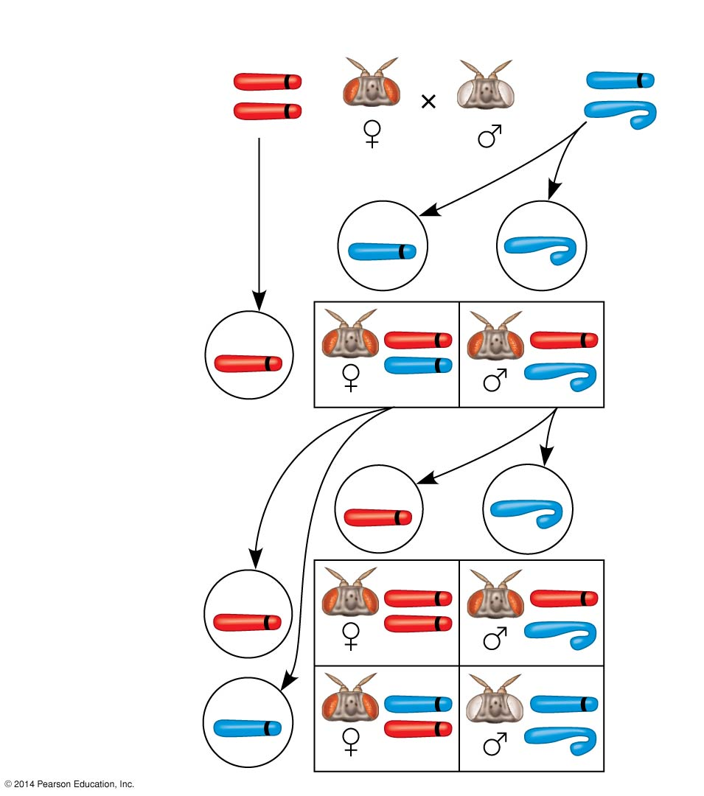
Conclusion
P
Generation
w⁺
w
X
X
X
Y
w⁺
w
Sperm
Eggs
F₁
Generation
w⁺
w⁺
w⁺
w
w⁺
Sperm
Eggs
w⁺
w⁺
F₂
Generation
w⁺
w⁺
w
w
w
w⁺
Notes:
66
Figure 12.4b Inquiry: In a cross between a wild-type female fruit fly and a mutant white-eyed male, what color eyes will the F₁ and F₂ offspring have? (part 2: conclusion)

Slide 67
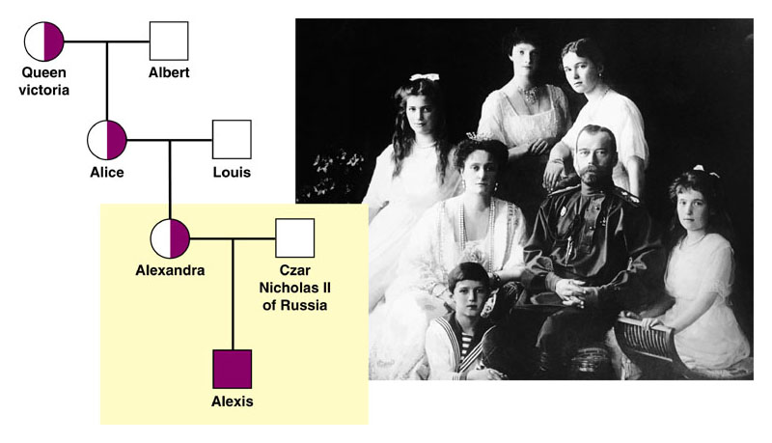
Hemophilia – Sex-linked Trait

Slide 68
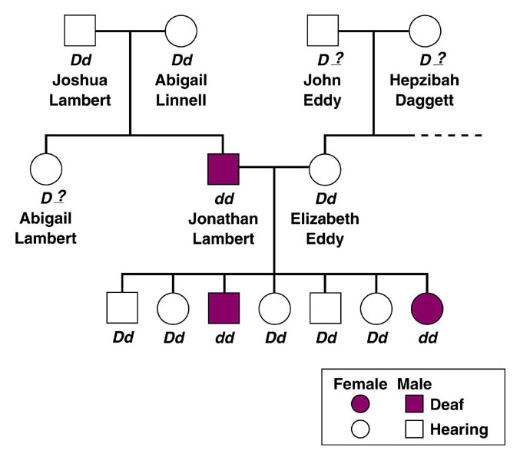
Human Pedigrees

Slide 69
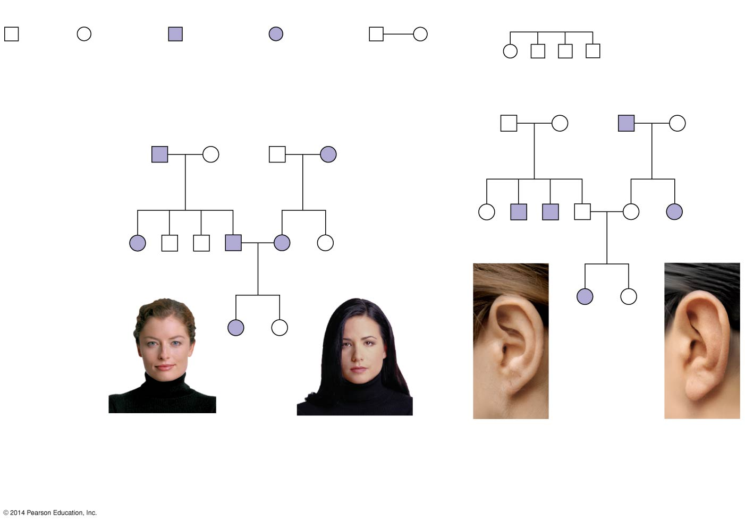
Figure 11.14
Key
Male
Female
Affected
male
Affected
female
Mating
Offspring, in
birth order
(first-born on left)
1st generation
(grandparents)
Ff
Ff
ff
Ff
Ww
ww
ww
Ww
2nd generation
(parents,
aunts, and
uncles)
FF or
Ff
ff
ff
Ff
Ff
ff
Ww
ww
ww
Ww
Ww
ww
3rd generation
(two sisters)
ff
FF
or
Ff
WW
or
Ww
ww
Widow’s peak
No widow’s peak
Attached
earlobe
Free
earlobe
(a) Is a widow’s peak a dominant or recessive trait?
(b) Is an attached earlobe a dominant
or recessive trait?
Notes:
69
Figure 11.14 Pedigree analysis

Slide 70
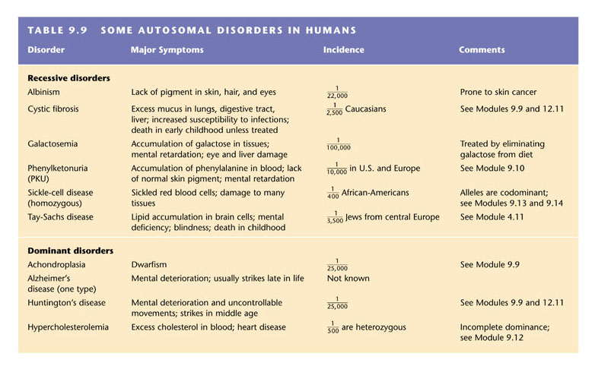

Slide 71
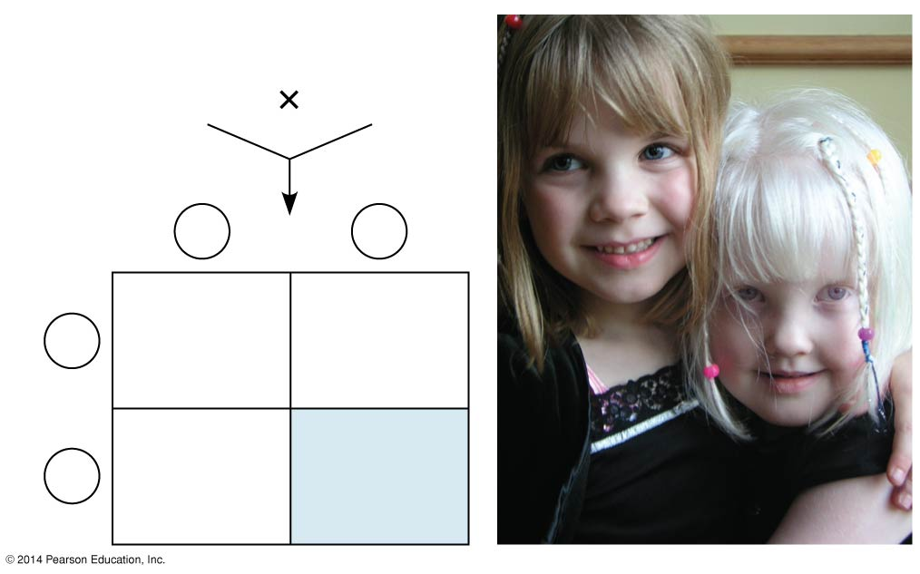
Figure 11.15
Parents
Normal
Aa
Normal
Aa
Sperm
A
a
Eggs
Aa
Normal
(carrier)
AA
Normal
A
Aa
Normal
(carrier)
aa
Albino
a
Notes:
71
Figure 11.15 Albinism: a recessive trait

Slide 72
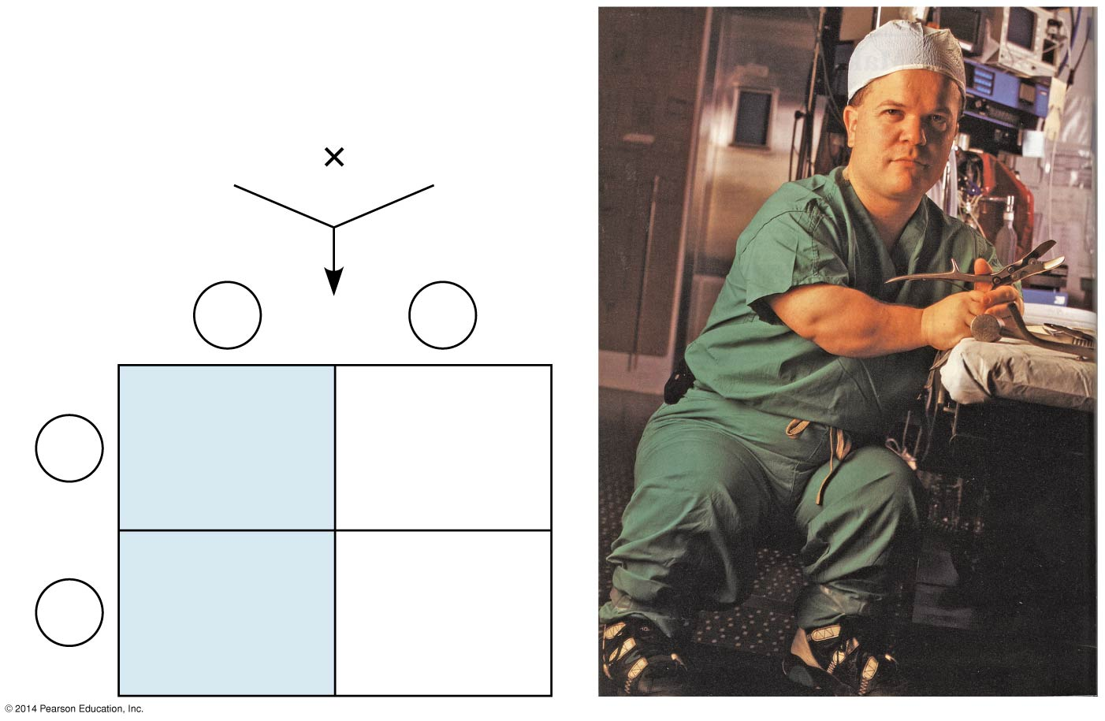
Parents
Dwarf
Dd
Normal
dd
Sperm
D
d
Eggs
Dd
Dwarf
dd
Normal
d
Dd
Dwarf
dd
Normal
d
Notes:
72
Figure 11.16 Achondroplasia: a dominant trait

Slide 73
