Slide 1
Gene Regulation

Slide 2
How is it possible that each kind of cell looks and functions differently from one another if all cells in your body contain the same exact copy of DNA ?
Regulation of Gene Expression

Slide 3
Several Levels in Which to Control Gene Expression
Pre-transcriptional level
Transcriptional level
Post-transcriptional level
Translational level
Post-translational level

Slide 4
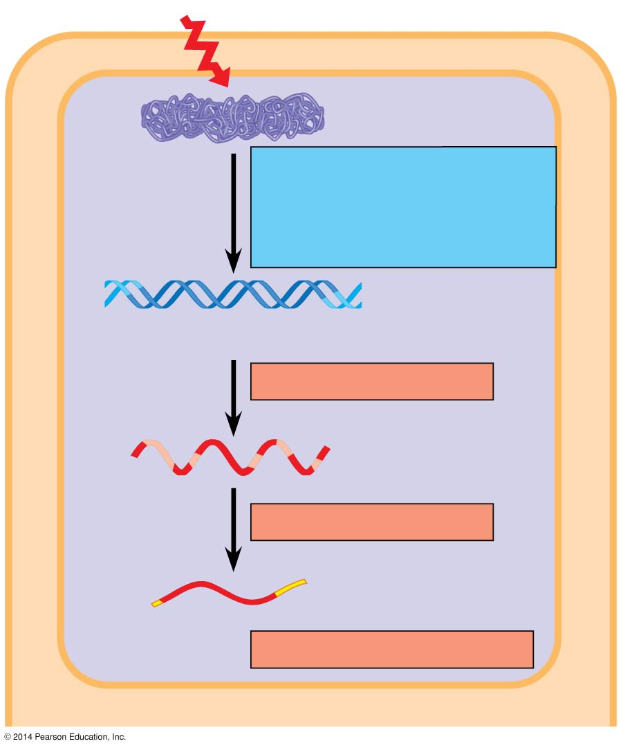
Regulation in the Nucleus
Signal
NUCLEUS
Chromatin
Chromatin modification: DNA unpacking involving histone acetylation and DNA demethylation
DNA
Gene available for transcription
Gene
Transcription
RNA
Exon
Primary transcript
Intron
RNA processing
Tail
Cap
mRNA in nucleus
Transport to cytoplasm
CYTOPLASM
Notes:
4
Figure 15.6a Stages in gene expression that can be regulated in eukaryotic cells (part 1: nucleus)

Slide 5
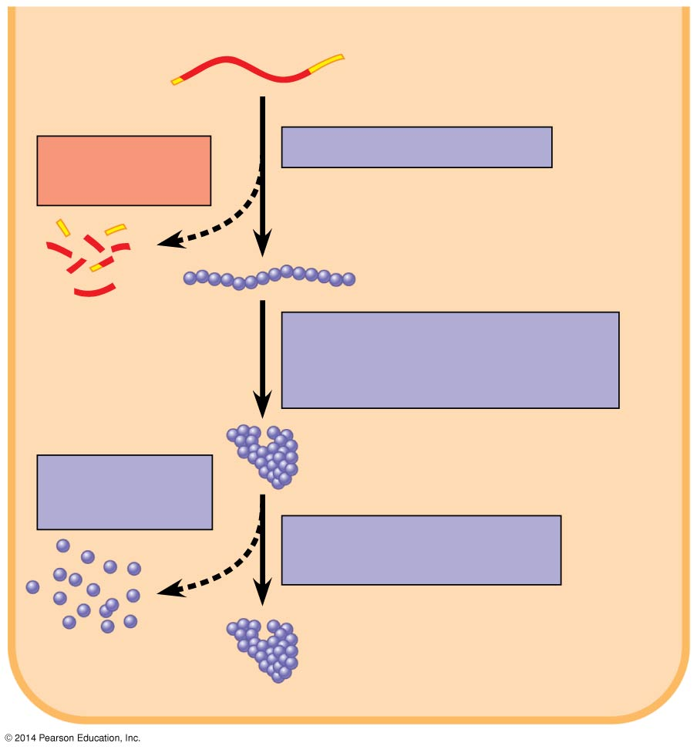
Regulation in the Cytoplasm
CYTOPLASM
mRNA in cytoplasm
Degradation
of mRNA
Translation
Polypeptide
Protein processing, such as cleavage and chemical modification
Degradation of protein
Active protein
Transport to cellular destination
Cellular function (such as enzymatic activity, structural support)
Notes:
5
Figure 15.6b Stages in gene expression that can be regulated in eukaryotic cells (part 2: cytoplasm)

Slide 6
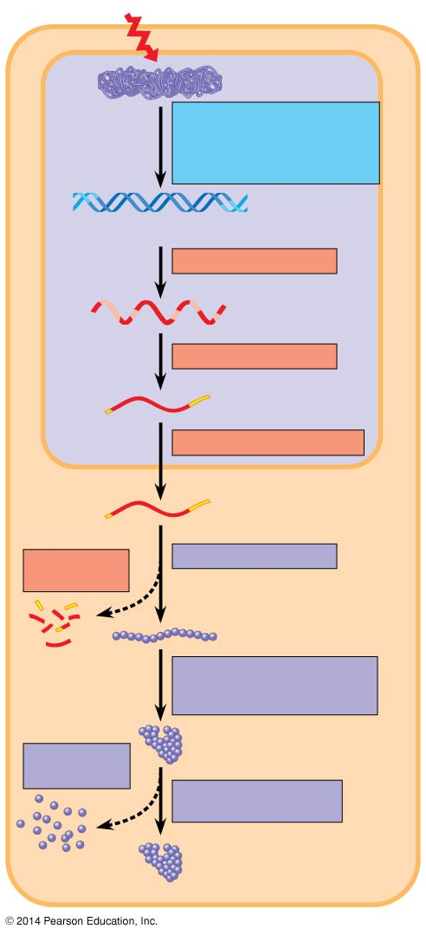
Signal
Chromatin
NUCLEUS
Chromatin modification: DNA unpacking involving histone acetylation and DNA demethylation
DNA
Gene available for transcription
Gene
Transcription
RNA
Exon
Primary transcript
Intron
RNA processing
Tail
Cap
mRNA in nucleus
Transport to cytoplasm
CYTOPLASM
mRNA in cytoplasm
Degradation
of mRNA
Translation
Polypeptide
Protein processing, such as cleavage and chemical modification
Degradation of protein
Active protein
Transport to cellular destination
Cellular function (such as enzymatic activity, structural support)
Notes:
6
Figure 15.6 Stages in gene expression that can be regulated in eukaryotic cells

Slide 7
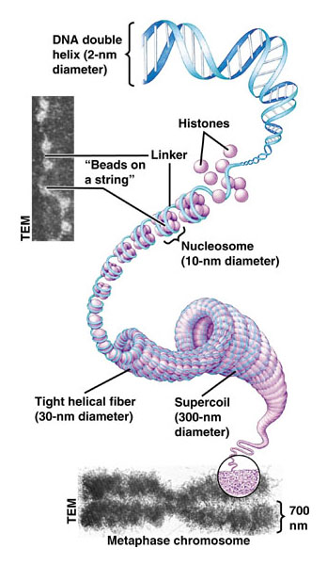
How does DNA packing in eukaryotes help to regulate gene expression? Pre-transcriptional Rebulation

Slide 8
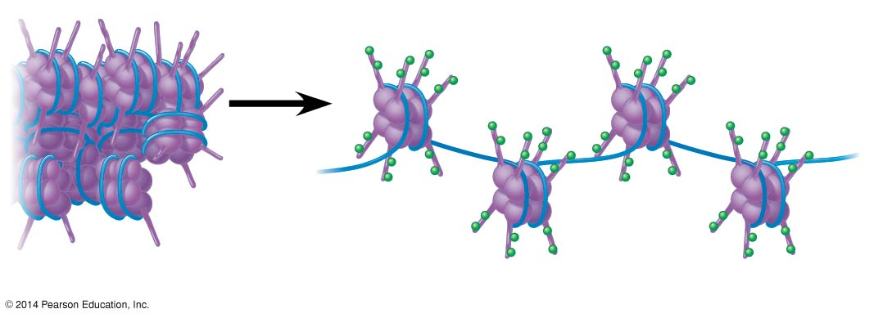
Unravelling of the Chromosome
Nucleosome
Histone tails
Unacetylated histones
Acetylated histones
Notes:
8
Figure 15.7 A simple model of the effect of histone acetylation

Slide 9
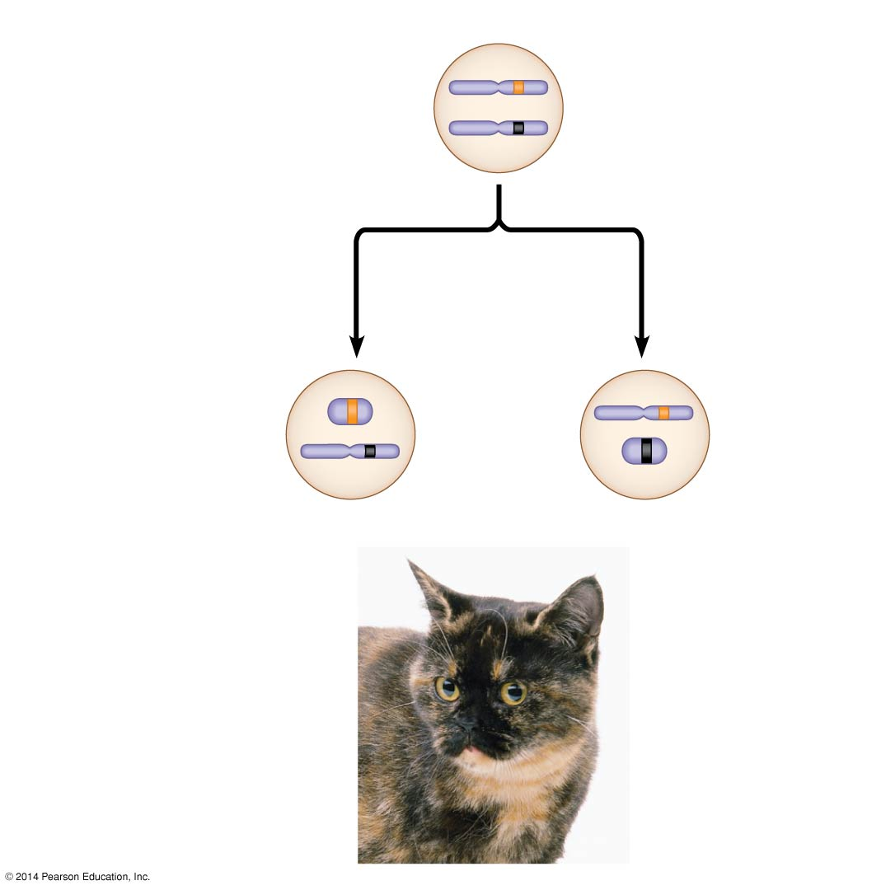
X chromosomes
Allele for
orange fur
Early embryo:
Allele for
black fur
Cell division and
X chromosome
inactivation
Two cell
populations
in adult cat:
Active X
Active X
Inactive
X
Black fur
Orange fur
Tight packing of the X chromosome in female mammals
(X inactivation)
Notes:
9
Figure 12.8 X inactivation and the tortoiseshell cat

Slide 10
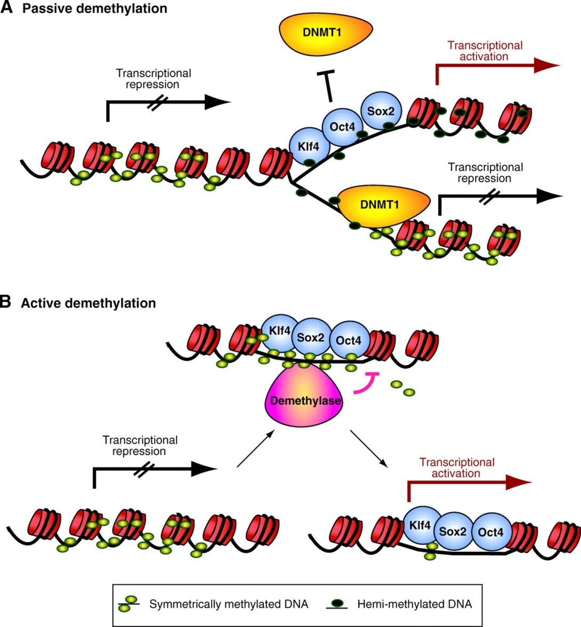
Demethylation of DNA

Slide 11
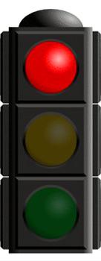
Transcriptional Level
A gene can be either turned “on” or “off”.
ON – the gene is expressed (i.e., the gene is transcribed and translated to form a protein)
OFF – the gene is not expressed (i.e., no transcription, no translation, no protein is formed)
Each kind of cell turns on only specific genes depending on its needs or function.

Slide 12
How does a cell turn on some genes and not others?
By way of regulatory sites (operators) found “upstream” from a gene and regulatory proteins that bind to these sites.

Slide 13
A Typical Gene

Slide 14
Gene Regulation: An Example
The best understood gene regulation process is the control of expression of the lac operon.
The “lac operon” is a group of genes found in E. coli (bacteria) that are expressed all at the same time under the control of the same promoter and the same regulatory site (operator).
This operon contains three genes that code for proteins that allow bacteria to use lactose (a sugar) as a food source.

Slide 15
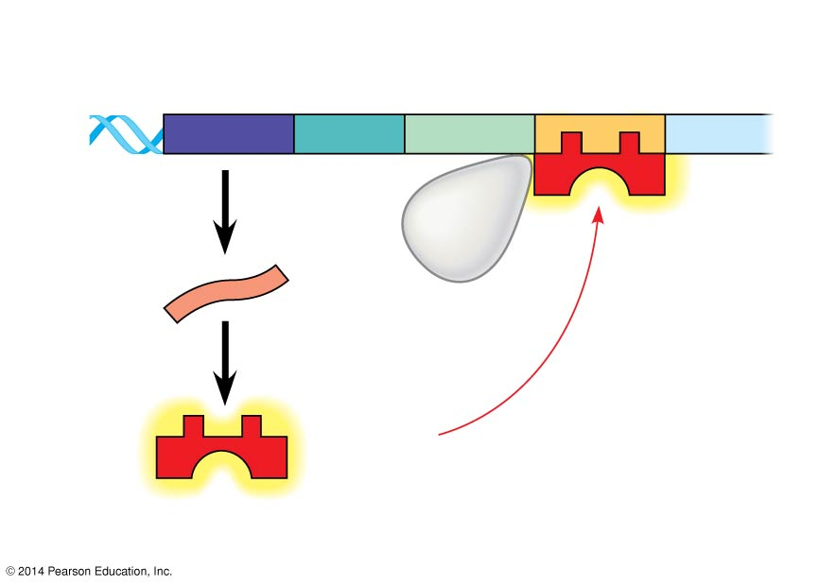
Regulatory
gene
Promoter
Operator
DNA
lacI
IacZ
No
RNA
made
3′
mRNA
RNA
polymerase
5′
Active
repressor
Protein
(a) Lactose absent, repressor active, operon off
Notes:
15
Figure 15.4a The lac operon in E. coli: regulated synthesis of inducible enzymes (part 1: lactose absent)

Slide 16
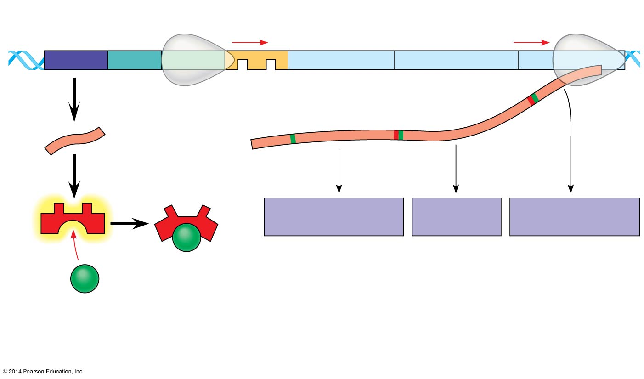
DNA
lac operon
IacI
IacZ
IacY
IacA
RNA polymerase
mRNA
3′
mRNA 5′
5′
Protein
β-Galactosidase
Permease
Transacetylase
Inactive
repressor
Allolactose (inducer)
(b) Lactose present, repressor inactive, operon on
Notes:
16
Figure 15.4b The lac operon in E. coli: regulated synthesis of inducible enzymes (part 2: lactose present)

Slide 17
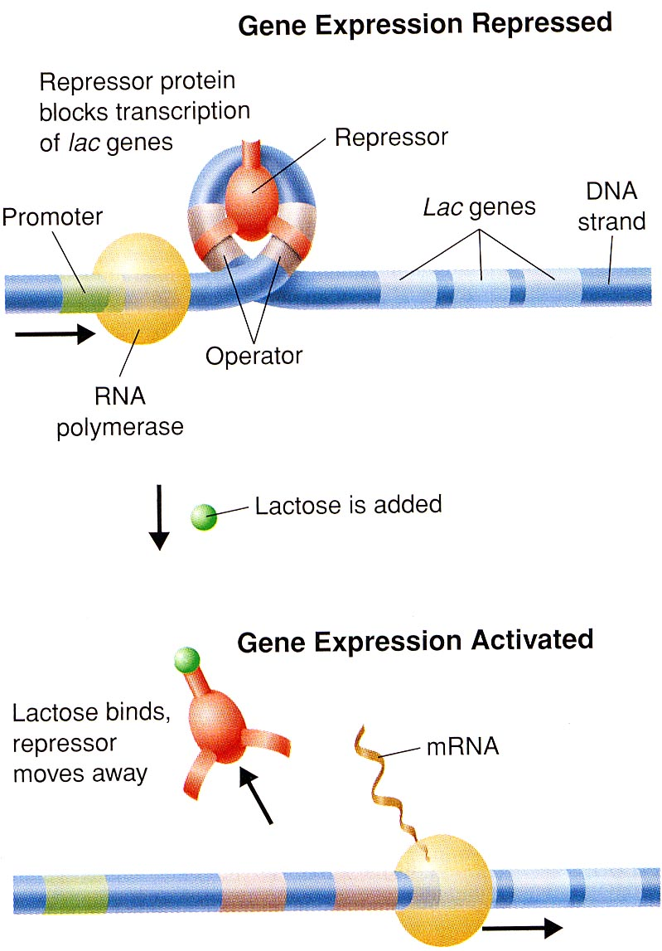
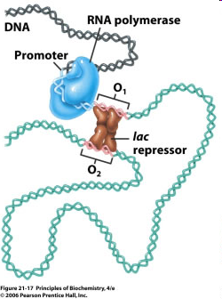

Slide 18
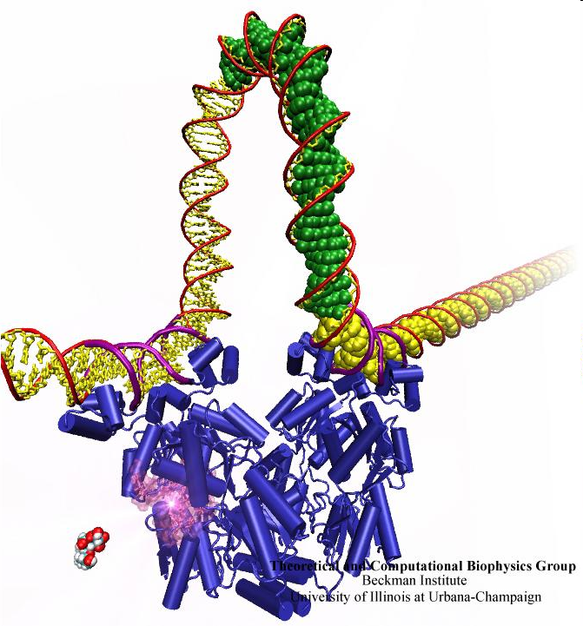
Promoter
Repressor Protein
Lactose

Slide 19
The lac genes are turned OFF by a “repressor protein”
and
turned ON by the presence of lactose.

Slide 20
In general, E. coli uses glucose as a food source and the lac genes are not expressed. In this state a repressor protein binds to the “operator” upstream from the lac genes and inhibits the transcription of the these genes by preventing RNA polymerase to bind to the promoter.

Slide 21
However, when the bacterium comes in contact with lactose, some lactose molecules enter the cell and bind to the repressor protein which causes its release from the operator. This now allows RNA polymerase to bind to the promoter region and therefore allows for the genes to be expressed.

Slide 22
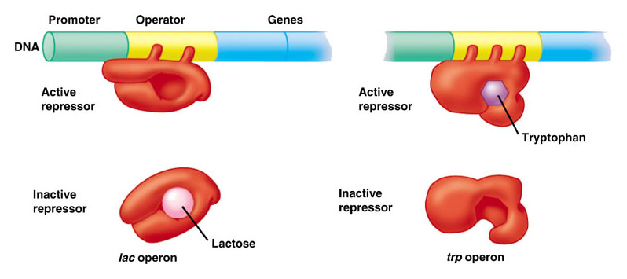
Lac vs. Trp Operon Regulation

Slide 23
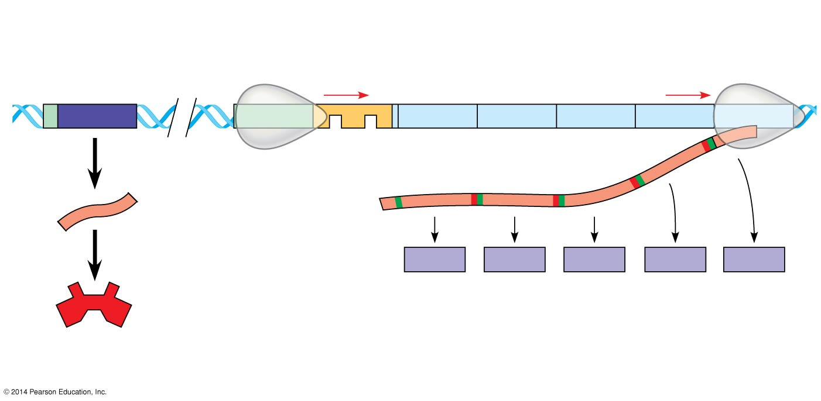
DNA
trp operon
Promoter
Regulatory
gene
Promoter
Genes of operon
trpR
trpE
trpD
trpC
trpB
trpA
RNA
polymerase
Operator
Start codon
Stop codon
mRNA
3′
mRNA 5′
5′
Protein
E
D
C
B
A
Inactive
repressor
Polypeptide subunits that make up
enzymes for tryptophan synthesis
(a) Tryptophan absent, repressor inactive, operon on
Notes:
23
Figure 15.3a The trp operon in E. coli: regulated synthesis of repressible enzymes (part 1: tryptophan absent)

Slide 24
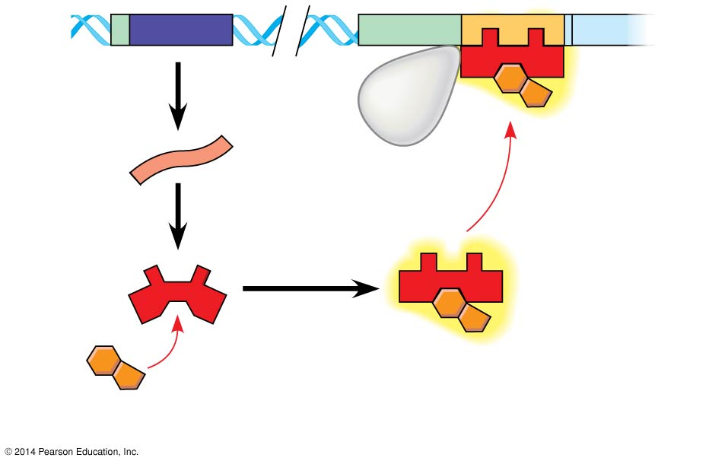
DNA
No RNA
made
mRNA
Protein
Active
repressor
Tryptophan
(corepressor)
(b) Tryptophan present, repressor active, operon off
Notes:
24
Figure 15.3b The trp operon in E. coli: regulated synthesis of repressible enzymes (part 2: tryptophan present)

Slide 25
Transcription Factors
In eukaryotic cells, the default state for most genes is « off »
For housekeeping genes the default state is « on »
RNA polymerase needs « transcription factors » in order to attach itself to a promoter and therefore transcribe the DNA
Transcription factors fall into two main categories; Activators and Repressors
Activator proteins bind to sequences of DNA upstream or downstream from the promoter called enhancers
Repressor proteins bind to sequences of DNA called silencers

Slide 26
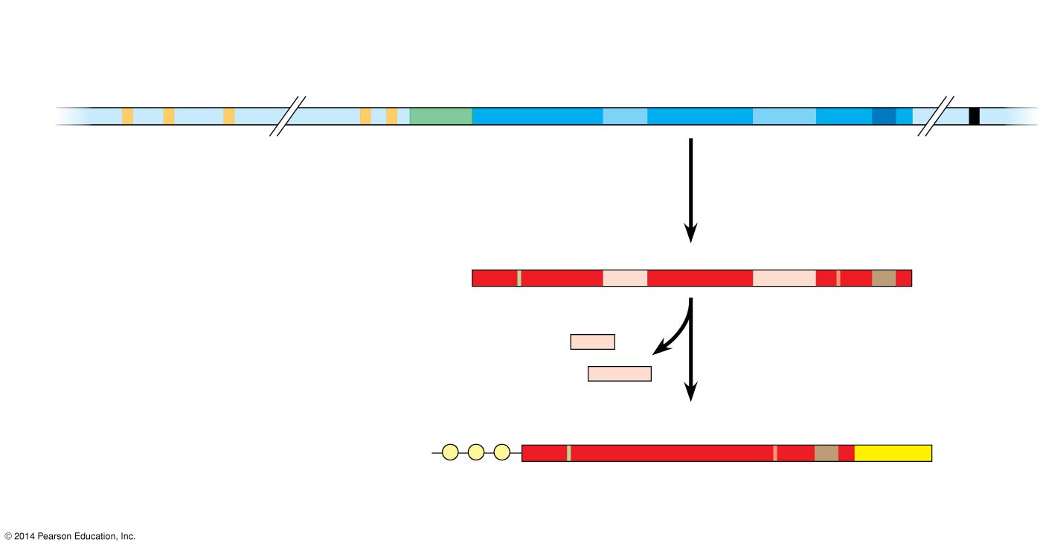
Enhancer (distal control elements)
Proximal control
elements
Poly-A signal sequence
Transcription termination region
Transcription start site
Exon
Intron
Exon
Intron
Exon
DNA
Upstream
Promoter
Down- stream
Transcription
Poly-A signal
Primary RNA transcript (pre-mRNA)
Exon
Intron
Exon
Intron
Exon
5′
Cleaved 3′ end of primary transcript
RNA processing
Intron RNA
Coding segment
mRNA
G
P
P
P
AAA…AAA
3′
5′
Cap
5′
UTR
Start codon
Stop codon
3′
UTR
Poly-A tail
Notes:
26
Figure 15.8 A eukaryotic gene and its transcript

Slide 27
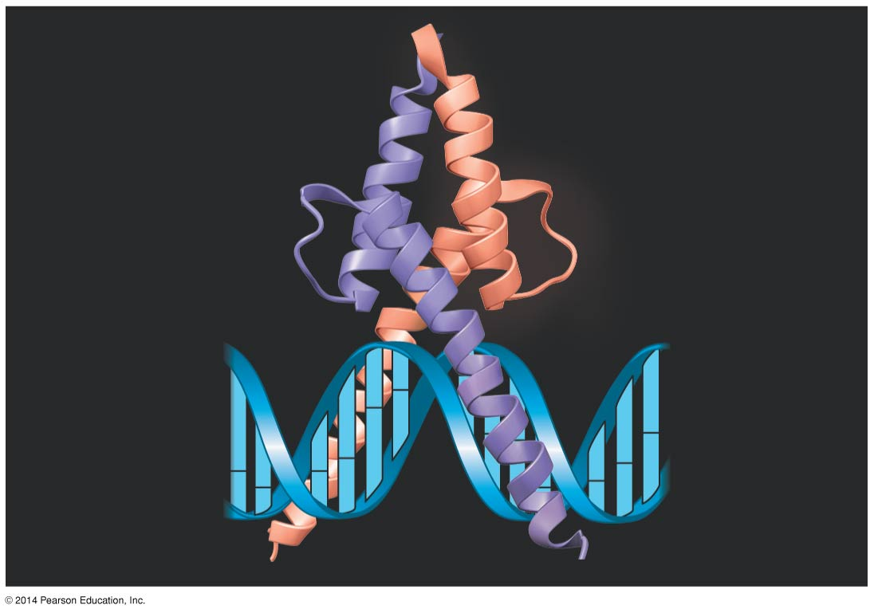
Activation domain
DNA-binding domain
DNA
Notes:
27
Figure 15.9 MyoD, a transcription activator

Slide 28
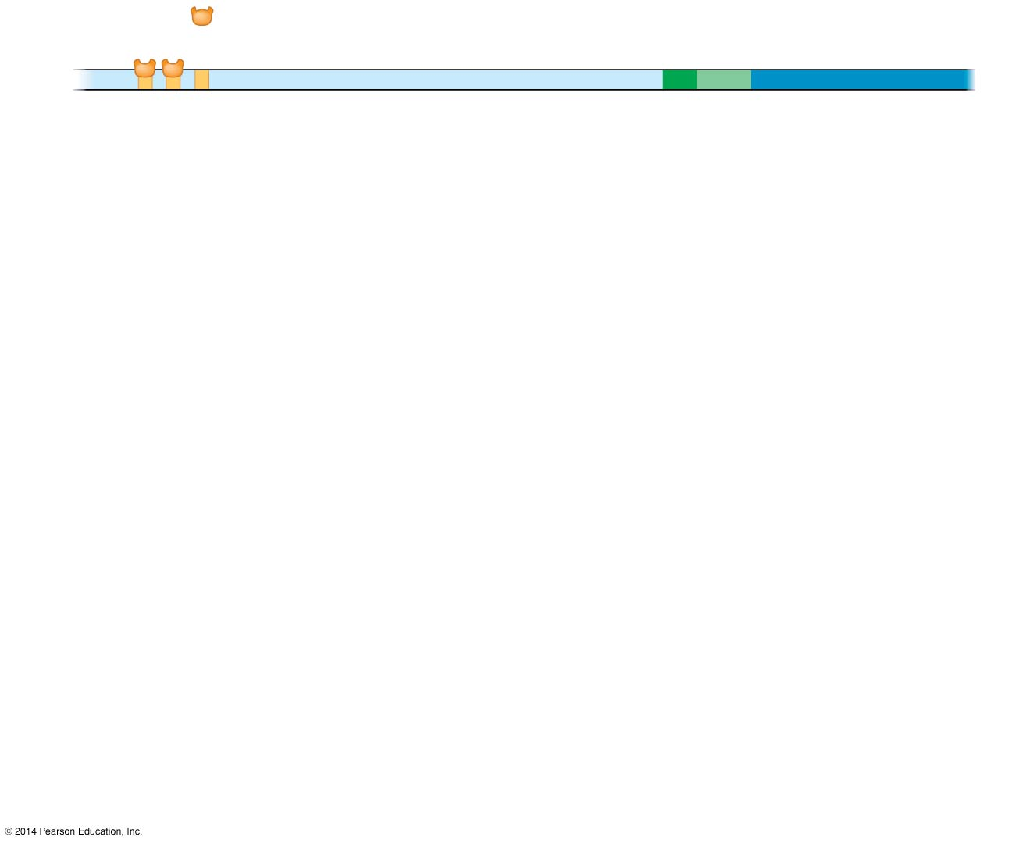
Activators
Promoter
Gene
DNA
Enhancer
Distal control element
TATA box
Notes:
28
Figure 15.10-1 A model for the action of enhancers and transcription activators (step 1)

Slide 29
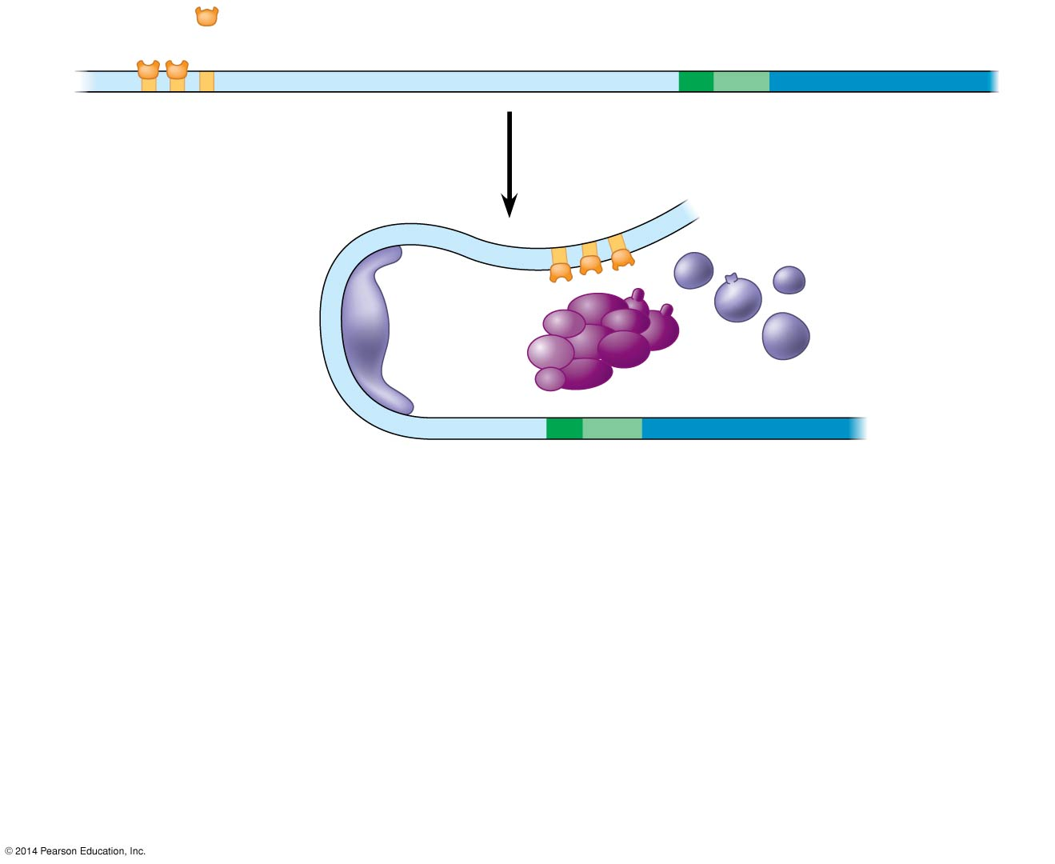
Activators
Promoter
Gene
DNA
Enhancer
Distal control element
TATA box
General transcription factors
DNA-
bending protein
Group of mediator proteins
Notes:
29
Figure 15.10-2 A model for the action of enhancers and transcription activators (step 2)

Slide 30
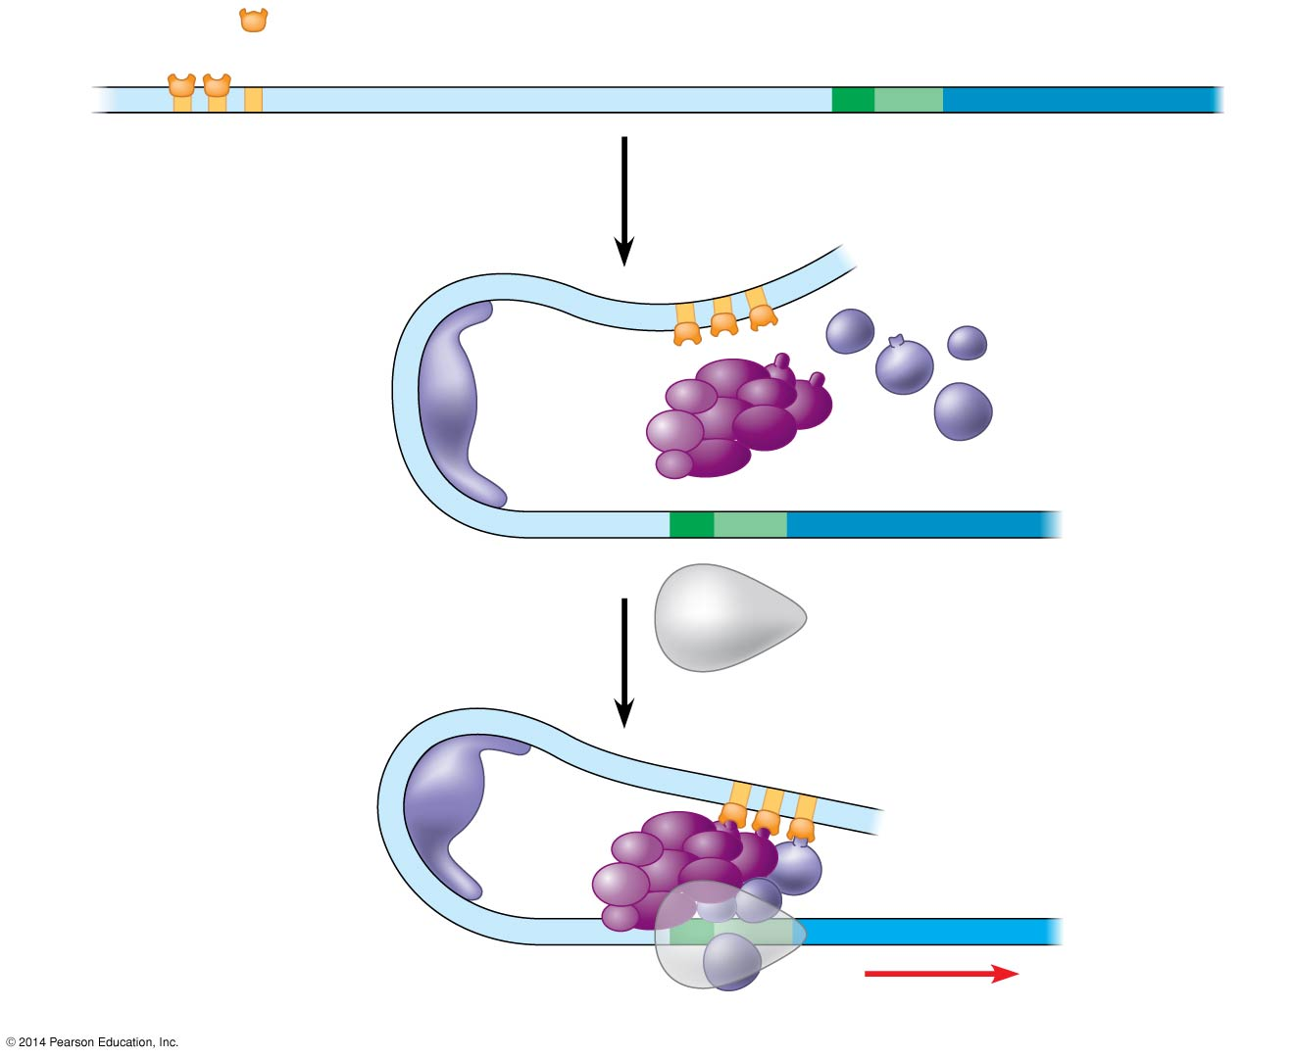
Activators
Promoter
Gene
DNA
Enhancer
Distal control element
TATA box
General transcription factors
DNA-
bending protein
Group of mediator proteins
RNA polymerase II
RNA polymerase II
Transcription initiation complex
RNA synthesis
Notes:
30
Figure 15.10-3 A model for the action of enhancers and transcription activators (step 3)

Slide 31
Differentiation
Results from selective gene expression
Example
Muscle cells – genes for creating actin and myosin are turned on to create muscle fibres
Pancreatic cells – genes that encode glucagon and insulin are turned on
Blood cells – genes encoding hemoglobin are turned on
Housekeeping genes – genes that are turned on in all cells that code for processes that all cells must undergo, like enzymes involved in glycolysis

Slide 32
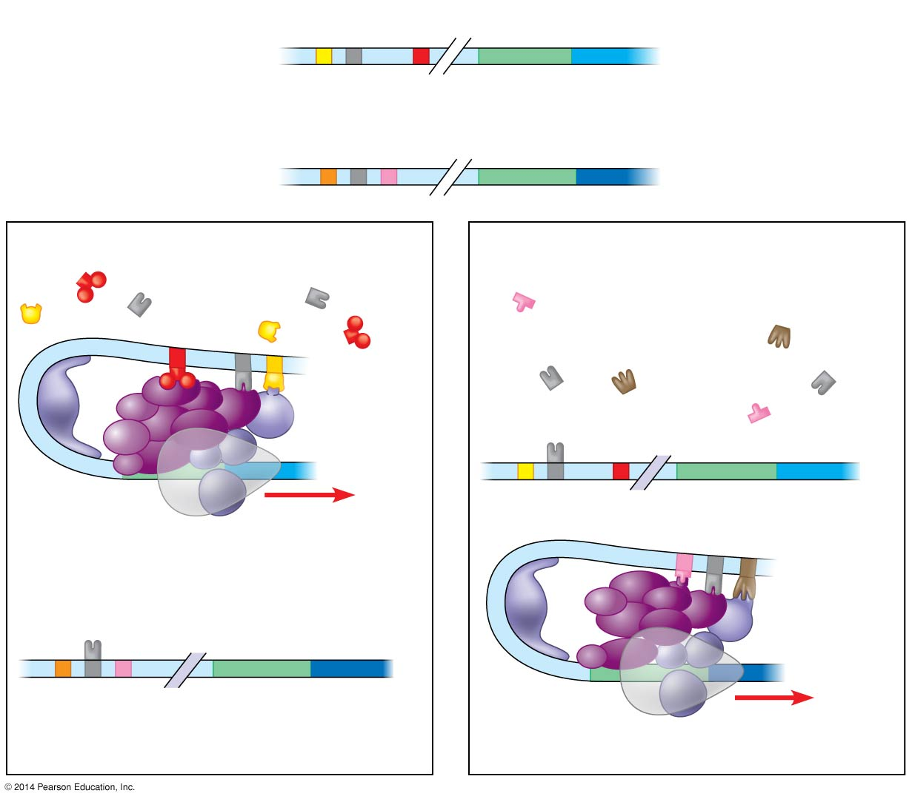
Enhancer
Promoter
Albumin gene
Control elements
Enhancer
Promoter
Crystallin gene
(a) LIVER CELL NUCLEUS
(b) LENS CELL NUCLEUS
Available activators
Available activators
Albumin gene not expressed
Albumin gene expressed
Crystallin gene not expressed
Crystallin gene expressed
Notes:
32
Figure 15.11 Cell type–specific transcription

Slide 33
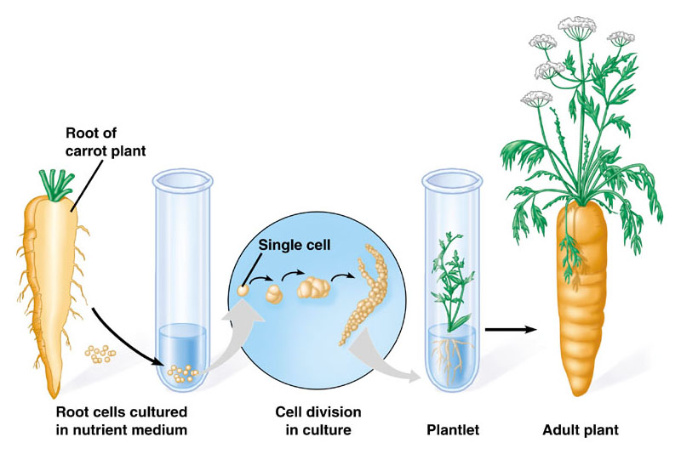
Dedifferentiation in Plants

Slide 34
How do eukaryotic cells turn on or off the genes of related functions located on different chromosomes?
They all use the same group of transcription factors & enhancers & silencers
This way the transcription factors will all bind at the same time and genes located in very different locations can be turned on or off simultaneously

Slide 35
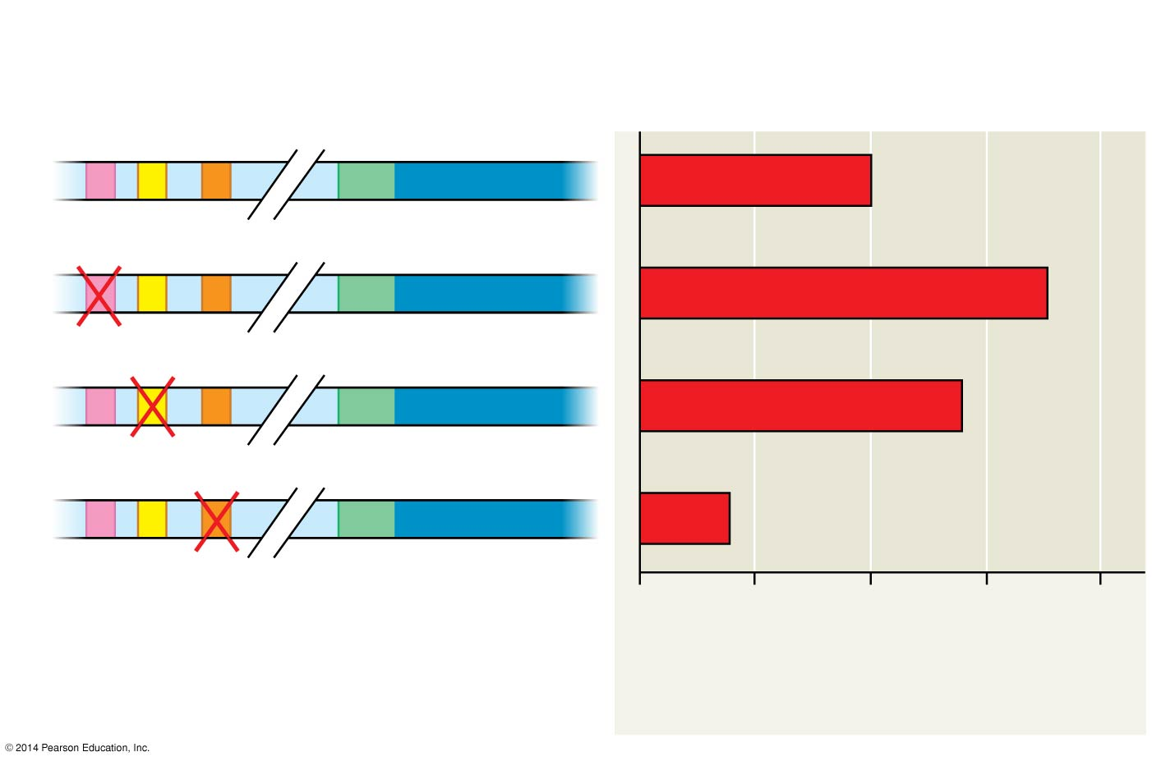
Enhancer with possible control elements
Reporter gene
Promoter
1
2
3
0
50
100
150
200
Relative level of reporter mRNA (% of control)
Notes:
35
Figure 15.UN04 Skills exercise: analyzing DNA deletion experiments

Slide 36
Regulation through RNA Splicing – Post-transcriptional Regulation
mRNA cannot leave the nucleus until splicing occurs since it has all of the splicing machinery attached to it and therefore cannot fit through the nuclear pores
Alternative splicing leads to the creation of two or more proteins from just one gene

Slide 37
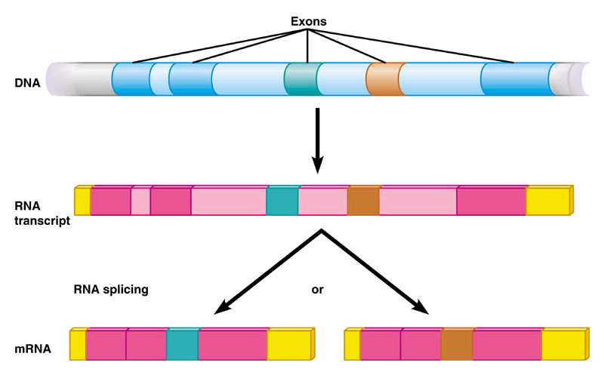

Slide 38
Other Regulators of Gene Expression
Breakdown of mRNA
Minutes after transcription in prokaryotes and hours to weeks in eukaryotes
Initiation of Translation
Protein Activation
Post-translational folding and cleavage
Protein Breakdown
Damaged proteins break down to form new ones
The breakdown of proteins allows the cell to quickly adapt to the change environment

Slide 40
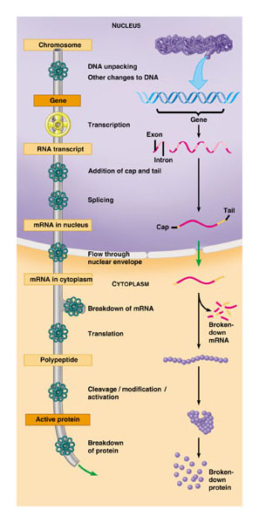

Slide 41
Animal Cloning

Slide 42
Nuclear Transplantation
First performed in the 50’s with frogs
Replacement of the nucleus of an egg cell or zygote cell with the nucleus of an adult somatic cell
This process can be used for two main purposes:
Reproductive Cloning
Therapeutic Cloning with the production of ES cells (embryonic stem cells)

Slide 43
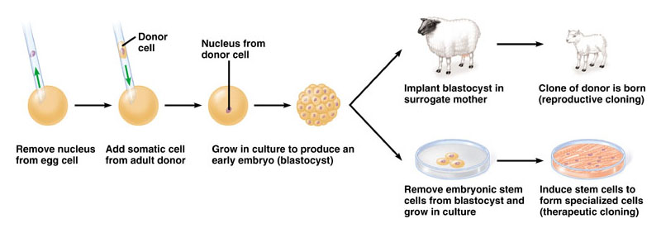

Slide 44
Reproductive Cloning
Has been done on frogs, sheep, mice, cats, cows, pigs, mules and monkeys!
Benefits:
Farmers create a identical herds with desired traits
Pharmaceutical companies can use certain cloned mammals to produce pharmaceutical drugs
Cloned pigs missing one of the proteins that cause immunal rejection in human transplant patients, may one day serve as transplant donors
Help repopulating endangered species?
Genetic research?
Disadvantages:
Ethics
Goes against evolution (decreases variation)

Slide 45
Therapeutic Cloning
Insert a patient’s nucleus into an enucleated ES cell so that the patient won’t reject the new cells because they will be genetically identical
Problem: ES cells come from destroying human embryos
Alternative: Use bone marrow cells, but they are not totipotent

Slide 46
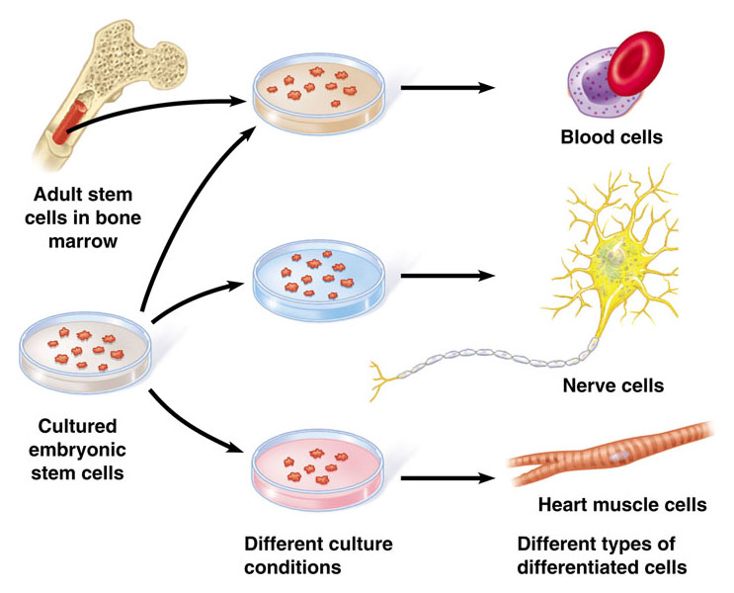

Slide 47
The Genetic Control of Embryonic Development

Slide 48
Gene Expression in Embryogenesis
Embryogenesis results from cascades of gene expression that allow for cell-to-cell signaling that direct embryonic development
Homeotic genes are master control genes that regulate batteries of other genes which will, in turn, determine the anatomy of parts of the body
This genetic approach to the study of embryogenesis has revolutionized developmental biology
Most of the what we know about embryogenesis comes from studies performed on fruit flies and a nematode called C. elegans

Slide 49
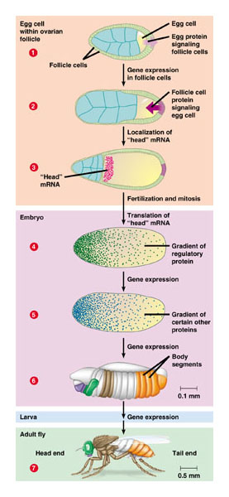
Regulation of Gene Expression in Drosophila

Slide 50
Signal Transduction Pathways & Gene Expression
How do adjacent cells communicate?
Through signal transduction pathways (« a series of molecular changes that conversts a signal on a target cell’s surface to a specific response inside the cell »)
Signal proteins from one cell will cause gene expression in adjacent cells
This type of communication is key to embryonic development and the coordination of cellular activities within a mature organism

Slide 51
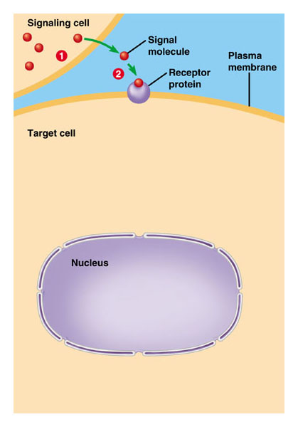
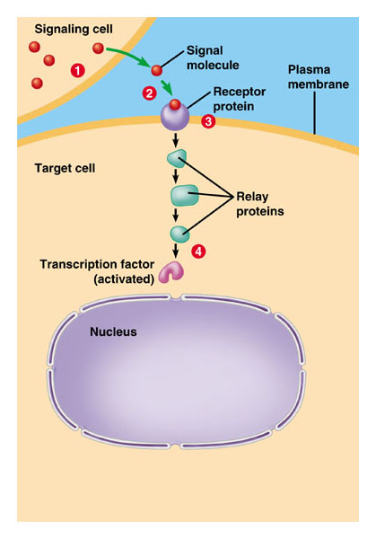
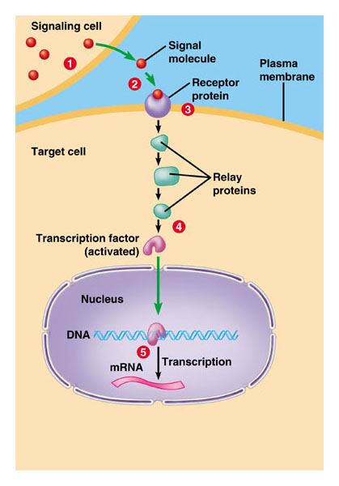
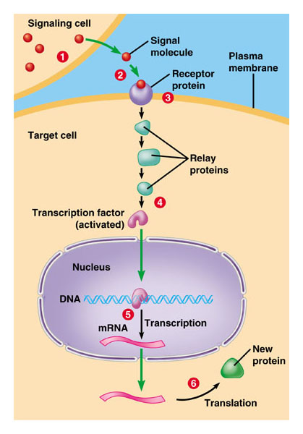

Slide 52
Homeotic Genes are Ancient
All homeotic genes contain a common sequence of 180 nucleotides called homeoboxes
These homeoboxes code for a 60-amino acid polypeptide chain in different homeotic proteins and enable them to bind to DNA and either turn on or turn off genes involved in embryonic development
These homeoboxes can be found in virtually every eukaryotic organism and have even been seen in some prokaryotic cells
The presence of homeoboxes in such a variety of organisms supports the idea that all life came from the same ancestor
The fact that these ancient genes are control genes underscores the importance of gene regulation in living organisms

Slide 53
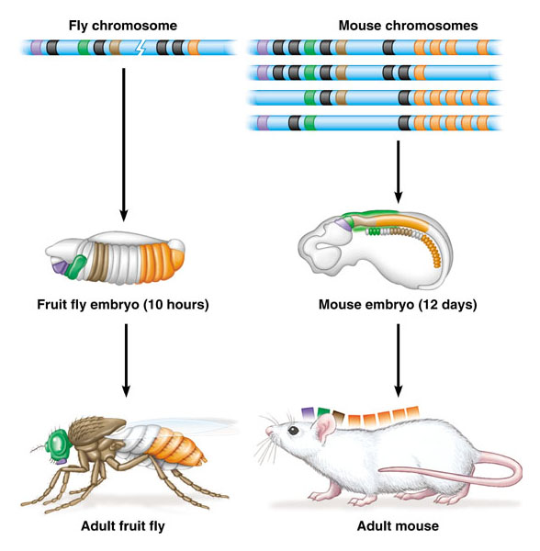

Slide 54
Genetic Basis of Cancer

Slide 55
Cancers are Triggered by the Deregulation of Cell Division
The deregulation of cell division in cancerous cells is due to mutations in genes that control the cell cycle
Our earliest understanding of cancer came from the discovery of a virus that causes cancer in chickens
This virus carries an oncongene (cancer-causing gene) that is a mutated version of normal gene found in chickens

Slide 56
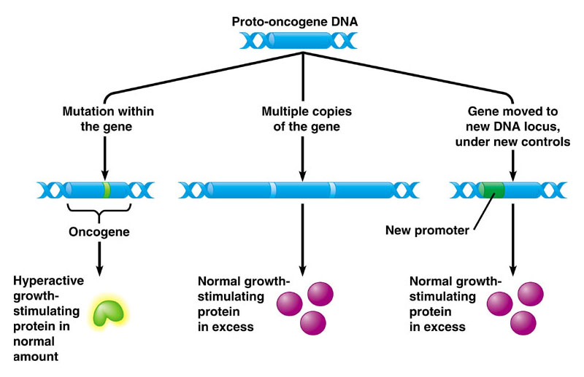

Slide 57
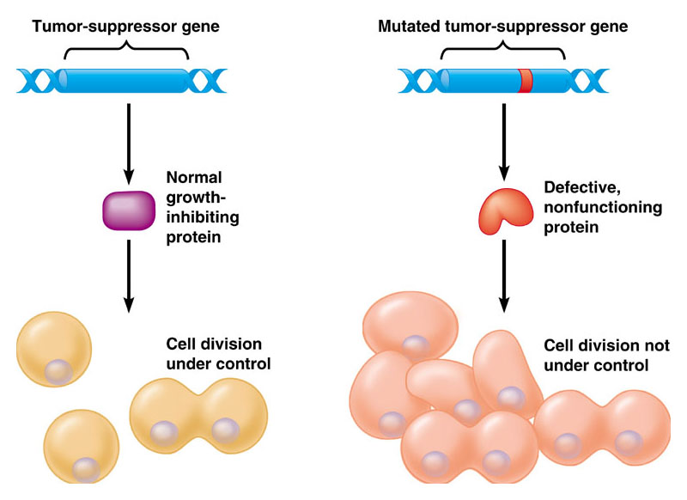
Tumor-Suppressor Genes

Slide 58
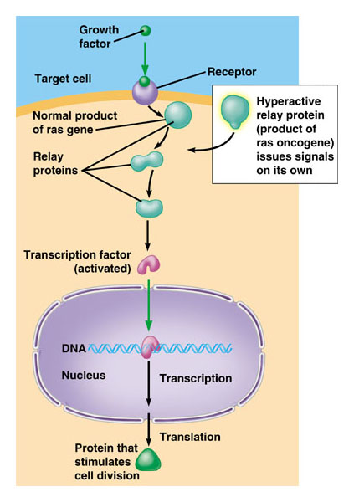

Slide 59
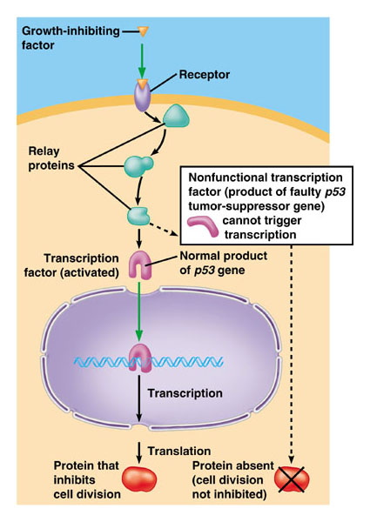

Slide 60
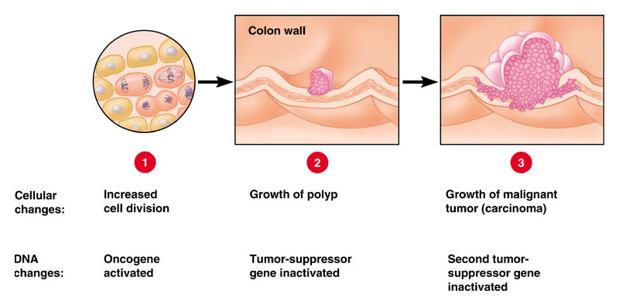
Stepwise Development of a Typical Colon Cancer

Slide 61
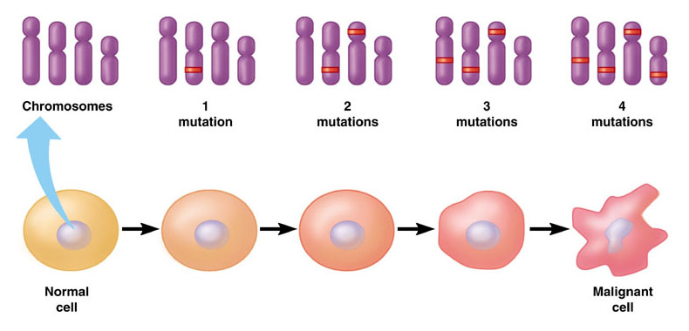
Cancer is the Result of Multiple Mutations

Slide 62
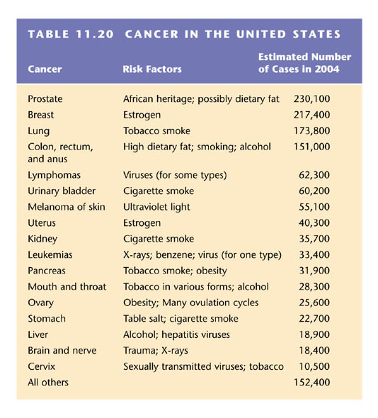

Slide 63
Activators
Promoter
Gene
DNA
Enhancer
Distal control element
TATA box
General transcription factors
DNA-
bending protein
Group of mediator proteins
RNA polymerase II
RNA polymerase II
Transcription initiation complex
RNA synthesis
Notes:
63
Figure 15.10-3 A model for the action of enhancers and transcription activators (step 3)

Slide 64
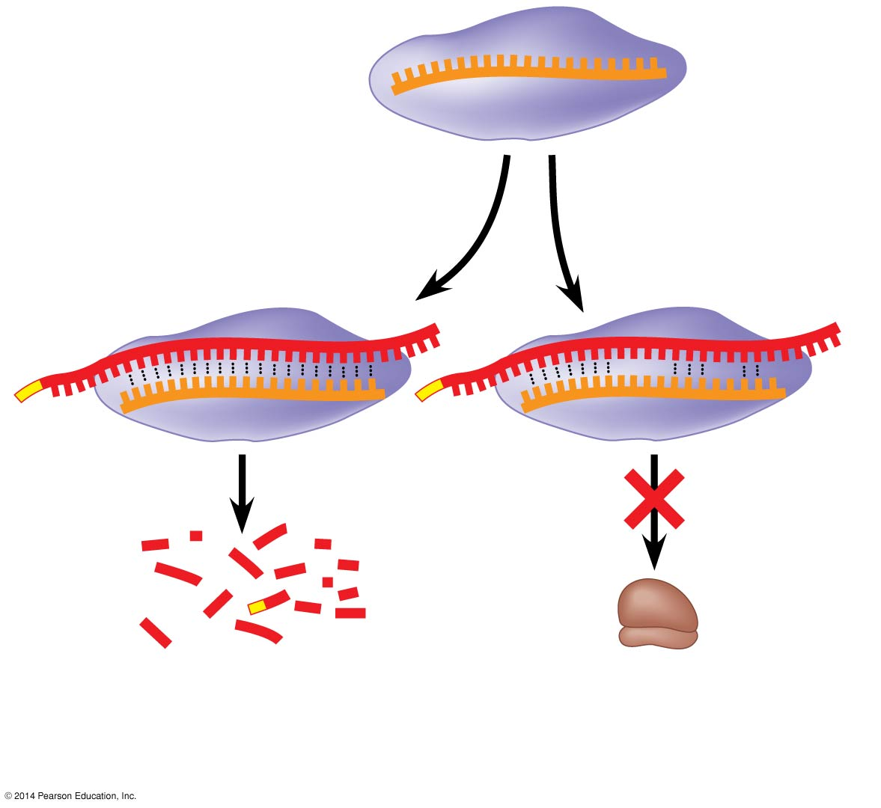
Figure 15.13
miRNA
miRNA- protein complex
1
The miRNA binds to a target mRNA.
mRNA degraded
Translation blocked
2
If bases are completely complementary, mRNA is degraded. If match is less than complete, translation is blocked.
Notes:
64
Figure 15.13 Regulation of gene expression by miRNAs

Slide 65
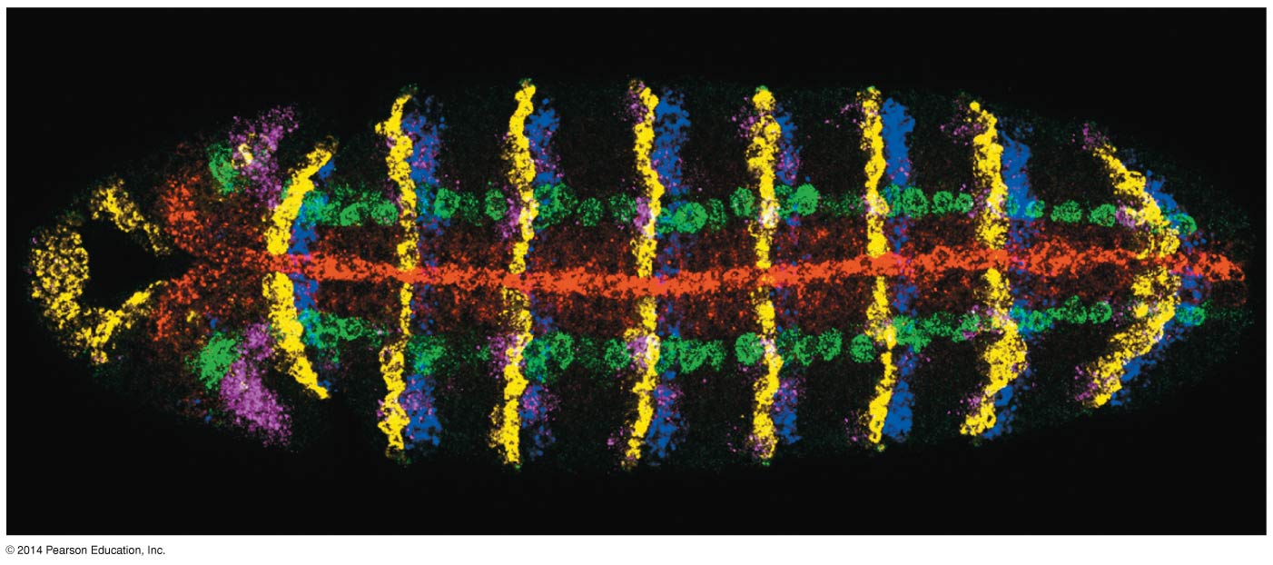
Figure 15.14
50 μm
Notes:
65
Figure 15.14 Determining where genes are expressed by in situ hybridization analysis

Slide 66
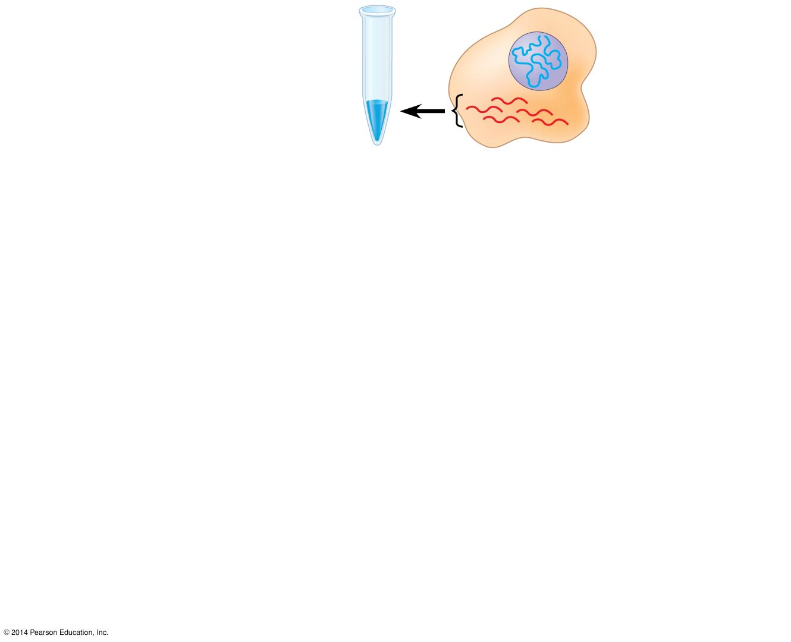
Figure 15.15-1
DNA in nucleus
1
Test tube containing reverse transcriptase and mRNA
mRNAs in cytoplasm
Notes:
66
Figure 15.15-1 Making complementary DNA (cDNA) from eukaryotic genes (step 1)

Slide 67
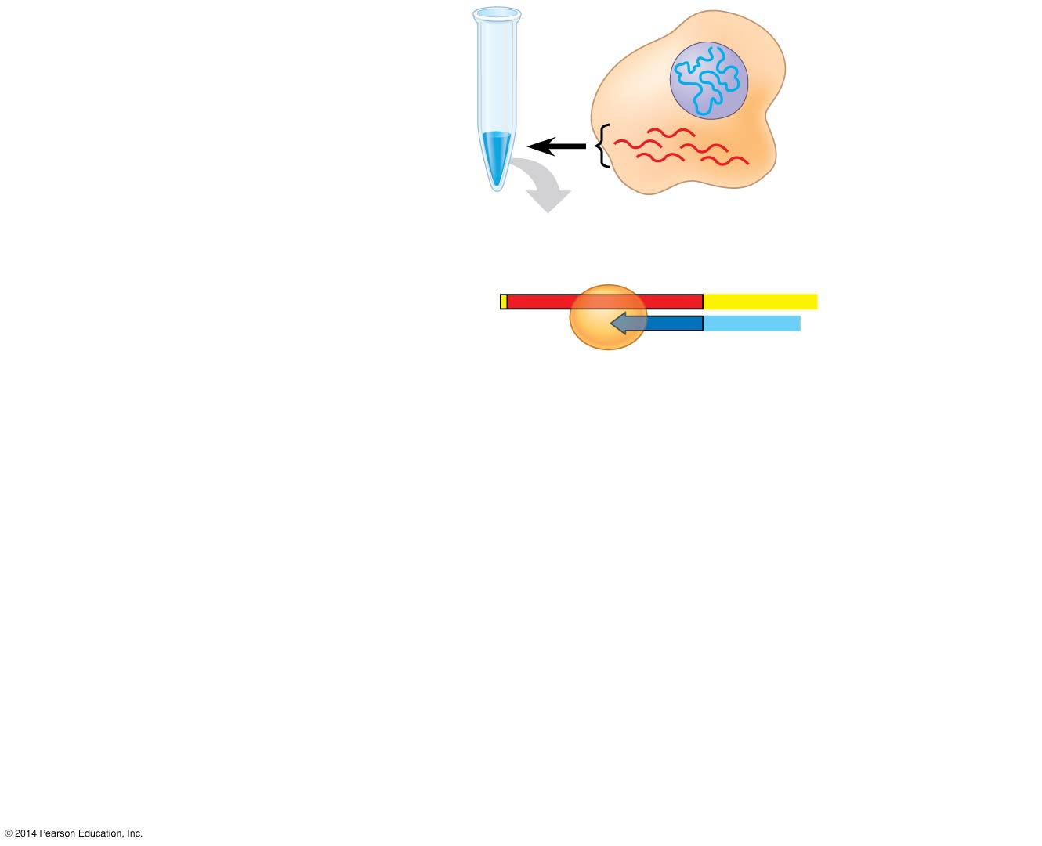
Figure 15.15-2
DNA in nucleus
1
Test tube containing reverse transcriptase and mRNA
mRNAs in cytoplasm
Reverse transcriptase
Poly-A tail
2
Reverse transcriptase makes the first DNA strand.
mRNA
5′
A A A A A A
3′
3′
T
T
T
T
T
5′
DNA strand
Primer
Notes:
67
Figure 15.15-2 Making complementary DNA (cDNA) from eukaryotic genes (step 2)

Slide 68
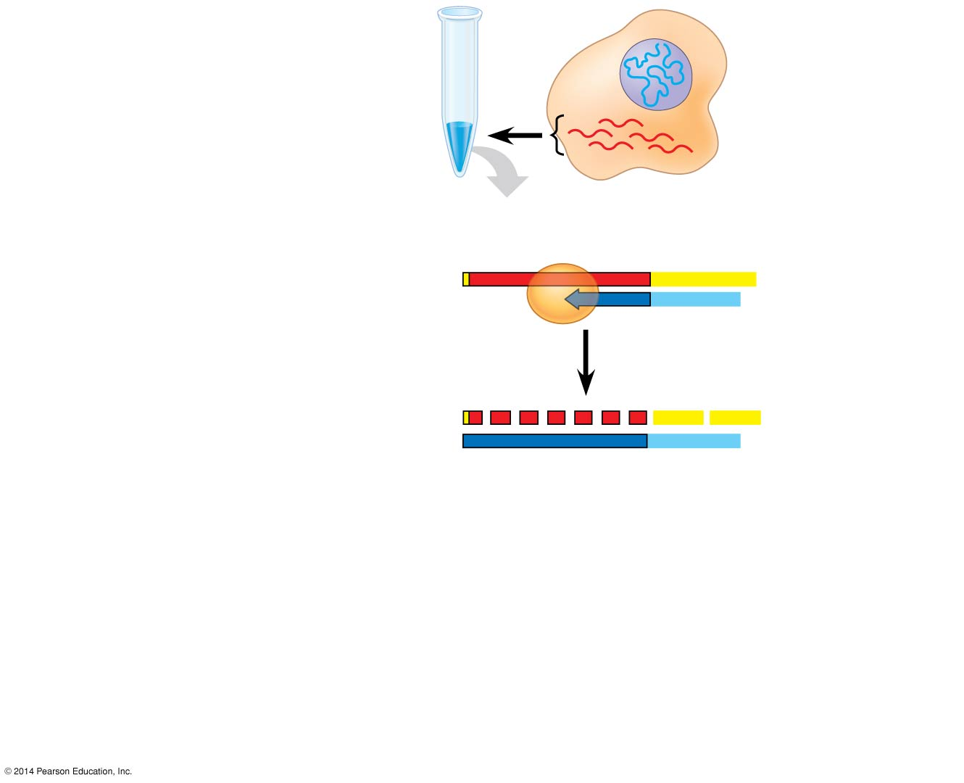
Figure 15.15-3
DNA in nucleus
1
Test tube containing reverse transcriptase and mRNA
mRNAs in cytoplasm
Reverse transcriptase
Poly-A tail
2
Reverse transcriptase makes the first DNA strand.
mRNA
5′
A A A A A A
3′
3′
T
T
T
T
T
5′
DNA strand
Primer
3
mRMA is degraded.
5′
A A A
A A A
3′
3′
T
T
T
T
T
5′
Notes:
68
Figure 15.15-3 Making complementary DNA (cDNA) from eukaryotic genes (step 3)

Slide 69
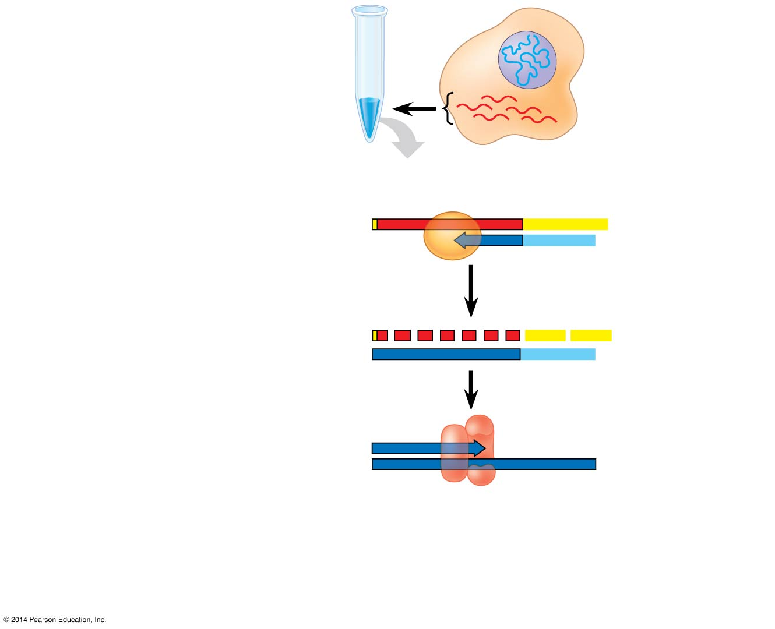
Figure 15.15-4
DNA in nucleus
1
Test tube containing reverse transcriptase and mRNA
mRNAs in cytoplasm
Reverse transcriptase
Poly-A tail
2
Reverse transcriptase makes the first DNA strand.
mRNA
5′
A A A A A A
3′
3′
T
T
T
T
T
5′
DNA strand
Primer
3
mRMA is degraded.
5′
A A A
A A A
3′
3′
T
T
T
T
T
5′
4
DNA polymerase synthesizes the second strand.
5′
3′
3′
5′
DNA polymerase
Notes:
69
Figure 15.15-4 Making complementary DNA (cDNA) from eukaryotic genes (step 4)

Slide 70
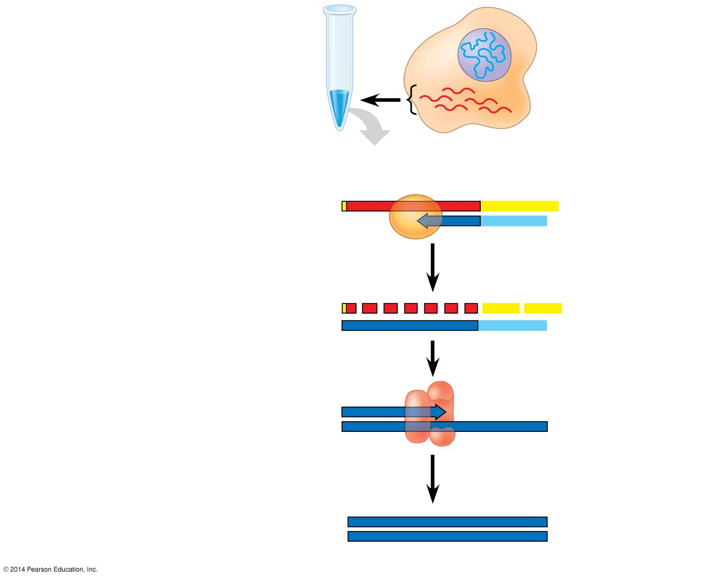
Figure 15.15-5
DNA in nucleus
1
Test tube containing reverse transcriptase and mRNA
mRNAs in cytoplasm
Reverse transcriptase
Poly-A tail
2
Reverse transcriptase makes the first DNA strand.
mRNA
5′
A A A A A A
3′
3′
T
T
T
T
T
5′
DNA strand
Primer
3
mRNA is degraded.
5′
A A A
A A A
3′
3′
T
T
T
T
T
5′
4
DNA polymerase synthesizes the second strand.
5′
3′
3′
5′
DNA polymerase
5
cDNA carries complete coding sequence without introns.
5′
3′
3′
5′
cDNA
Notes:
70
Figure 15.15-5 Making complementary DNA (cDNA) from eukaryotic genes (step 5)

Slide 71
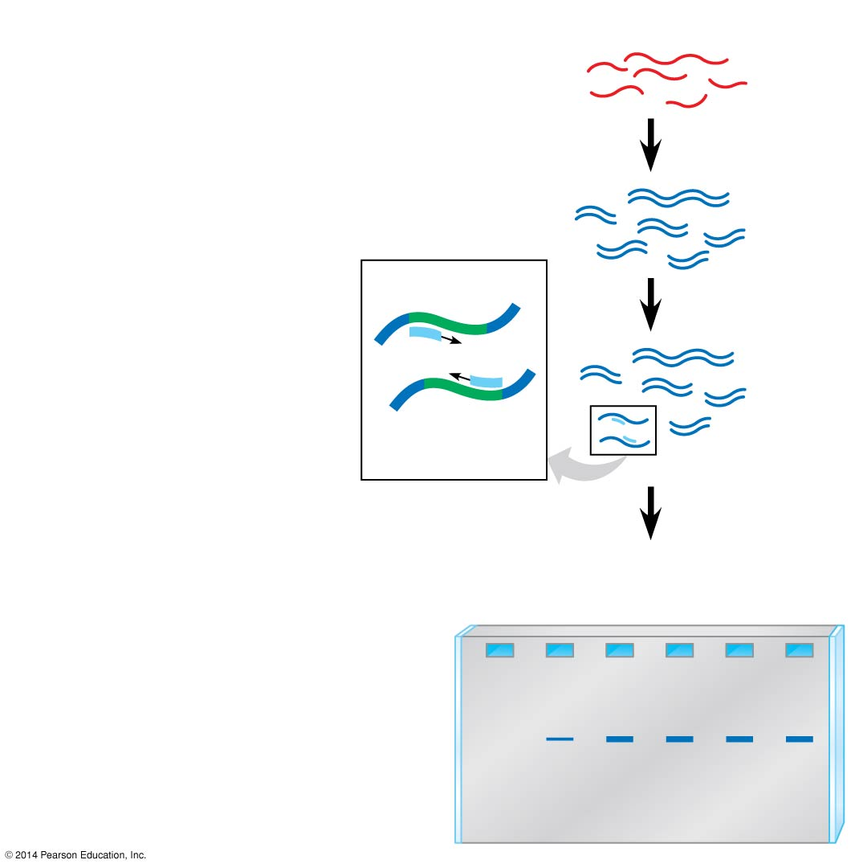
Figure 15.16
Technique
1
cDNA synthesis
mRNAs
cDNAs
Primers
2
PCR amplification
β-globin gene
3
Gel electrophoresis
Embryonic stages
Results
1
2
3
4
5
6
Notes:
71
Figure 15.16 Research method: RT-PCR analysis of the expression of single genes

Slide 72
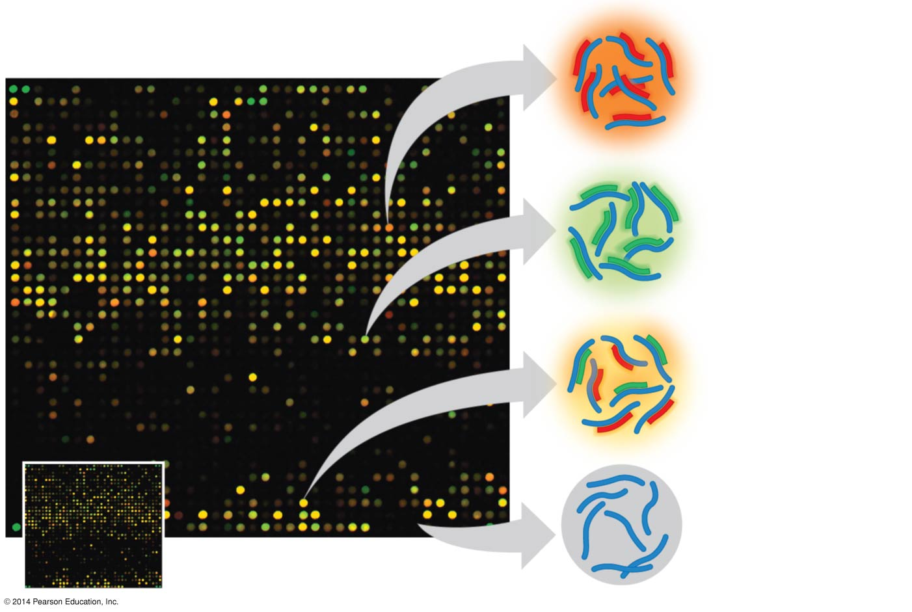
Figure 15.17
Genes in red wells expressed in first tissue.
Genes in green wells expressed in second tissue.
Genes in yellow wells expressed in both tissues.
Genes in black wells not expressed in either tissue.
DNA microarray
Notes:
72
Figure 15.17 DNA microarray assay of gene expression levels

Slide 73
Figure 15.UN01
Chromatin modification
Transcription
RNA processing
mRNA degradation
Translation
Protein processing and degradation
Notes:
Figure 15.UN01 In-text figure, regulation at the level of transcription, p. 301

Slide 74
Figure 15.UN02
Chromatin modification
Transcription
RNA processing
mRNA degradation
Translation
Protein processing and degradation
Notes:
74
Figure 15.UN02 In-text figure, regulation at the level of RNA processing, p. 304

Slide 75
Figure 15.UN03
Chromatin modification
Transcription
RNA processing
mRNA degradation
Translation
Protein processing and degradation
Notes:
75
Figure 15.UN03 In-text figure, regulation at the level of translation, p. 306

Slide 76
Figure 15.UN05
Genes expressed
Genes not expressed
Promoter
Genes
Operator
Active repressor: corepressor bound
Inactive repressor: no corepressor present
Corepressor
Notes:
76
Figure 15.UN05 Summary of key concepts: transcription regulation

Slide 77
Figure 15.UN06
Chromatin modification
Transcription
• Genes in highly compacted chromatin are generally not transcribed.
• Regulation of transcription initiation: DNA control elements in enhancers bind specific transcription factors.
• Histone acetylation seems to loosen chromatin structure, enhancing transcription.
Bending of the DNA enables activators to contact proteins at the promoter, initiating transcription.
• DNA methylation generally reduces transcription.
• The genes in a coordinately controlled group all share a combination of control elements.
Chromatin modification
RNA processing
Transcription
• Alternative RNA splicing:
Primary RNA transcript
RNA processing
mRNA
or
mRNA degradation
Translation
Translation
Protein processing and degradation
• Initiation of translation can be controlled via regulation of initiation factors.
mRNA degradation
Protein processing and degradation
• Each mRNA has a characteristic life span.
• Protein processing and degradation are subject to regulation.
Notes:
77
Figure 15.UN06 Summary of key concepts: eukaryotic regulation of gene expression

Slide 78
Figure 15.UN06a
Chromatin modification
Transcription
RNA processing
mRNA degradation
Translation
Protein processing and degradation
Notes:
78
Figure 15.UN06a Summary of key concepts: eukaryotic regulation of gene expression (part 1)

Slide 79
Figure 15.UN06b
Chromatin modification
RNA processing
• Genes in highly compacted chromatin are generally not transcribed.
• Alternative RNA splicing:
Primary RNA transcript
• Histone acetylation seems to loosen chromatin structure, enhancing transcription.
mRNA
or
Translation
• DNA methylation generally reduces transcription.
• Initiation of translation can be controlled via regulation of initiation factors.
mRNA degradation
Protein processing and degradation
• Each mRNA has a characteristic life span.
• Protein processing and degradation are subject to regulation.
Notes:
79
Figure 15.UN06b Summary of key concepts: eukaryotic regulation of gene expression (part 2)

Slide 80
Figure 15.UN06c
Transcription
• Regulation of transcription initiation: DNA control elements in enhancers bind specific transcription factors.
Bending of the DNA enables activators to contact proteins at the promoter, initiating transcription.
• The genes in a coordinately controlled group all share a combination of control elements.
Notes:
80
Figure 15.UN06c Summary of key concepts: eukaryotic regulation of gene expression (part 3)

Slide 81
Figure 15.UN07
Enhancer
Promoter
Gene 1
Gene 2
Gene 3
Gene 4
Gene 5
Notes:
81
Figure 15.UN07 Test your understanding, question 7 (activator proteins)

Slide 82
Exons
DNA
1
2
3
4
5
Troponin T gene
Primary RNA transcript
1
2
3
4
5
RNA splicing
mRNA
1
2
3
5
or
1
2
4
5
Notes:
82
Figure 15.12 Alternative RNA splicing of the troponin T gene

